Slide 1
Winter birding workshop
December 13, 2023

Slide 2
What are we going to cover?
-Why should I care about birding?
-How to identify birds
-Common winter species in the UP
-Tools and resources
-Creating bird habitat
-Bird feeders and how to make you own

Slide 3
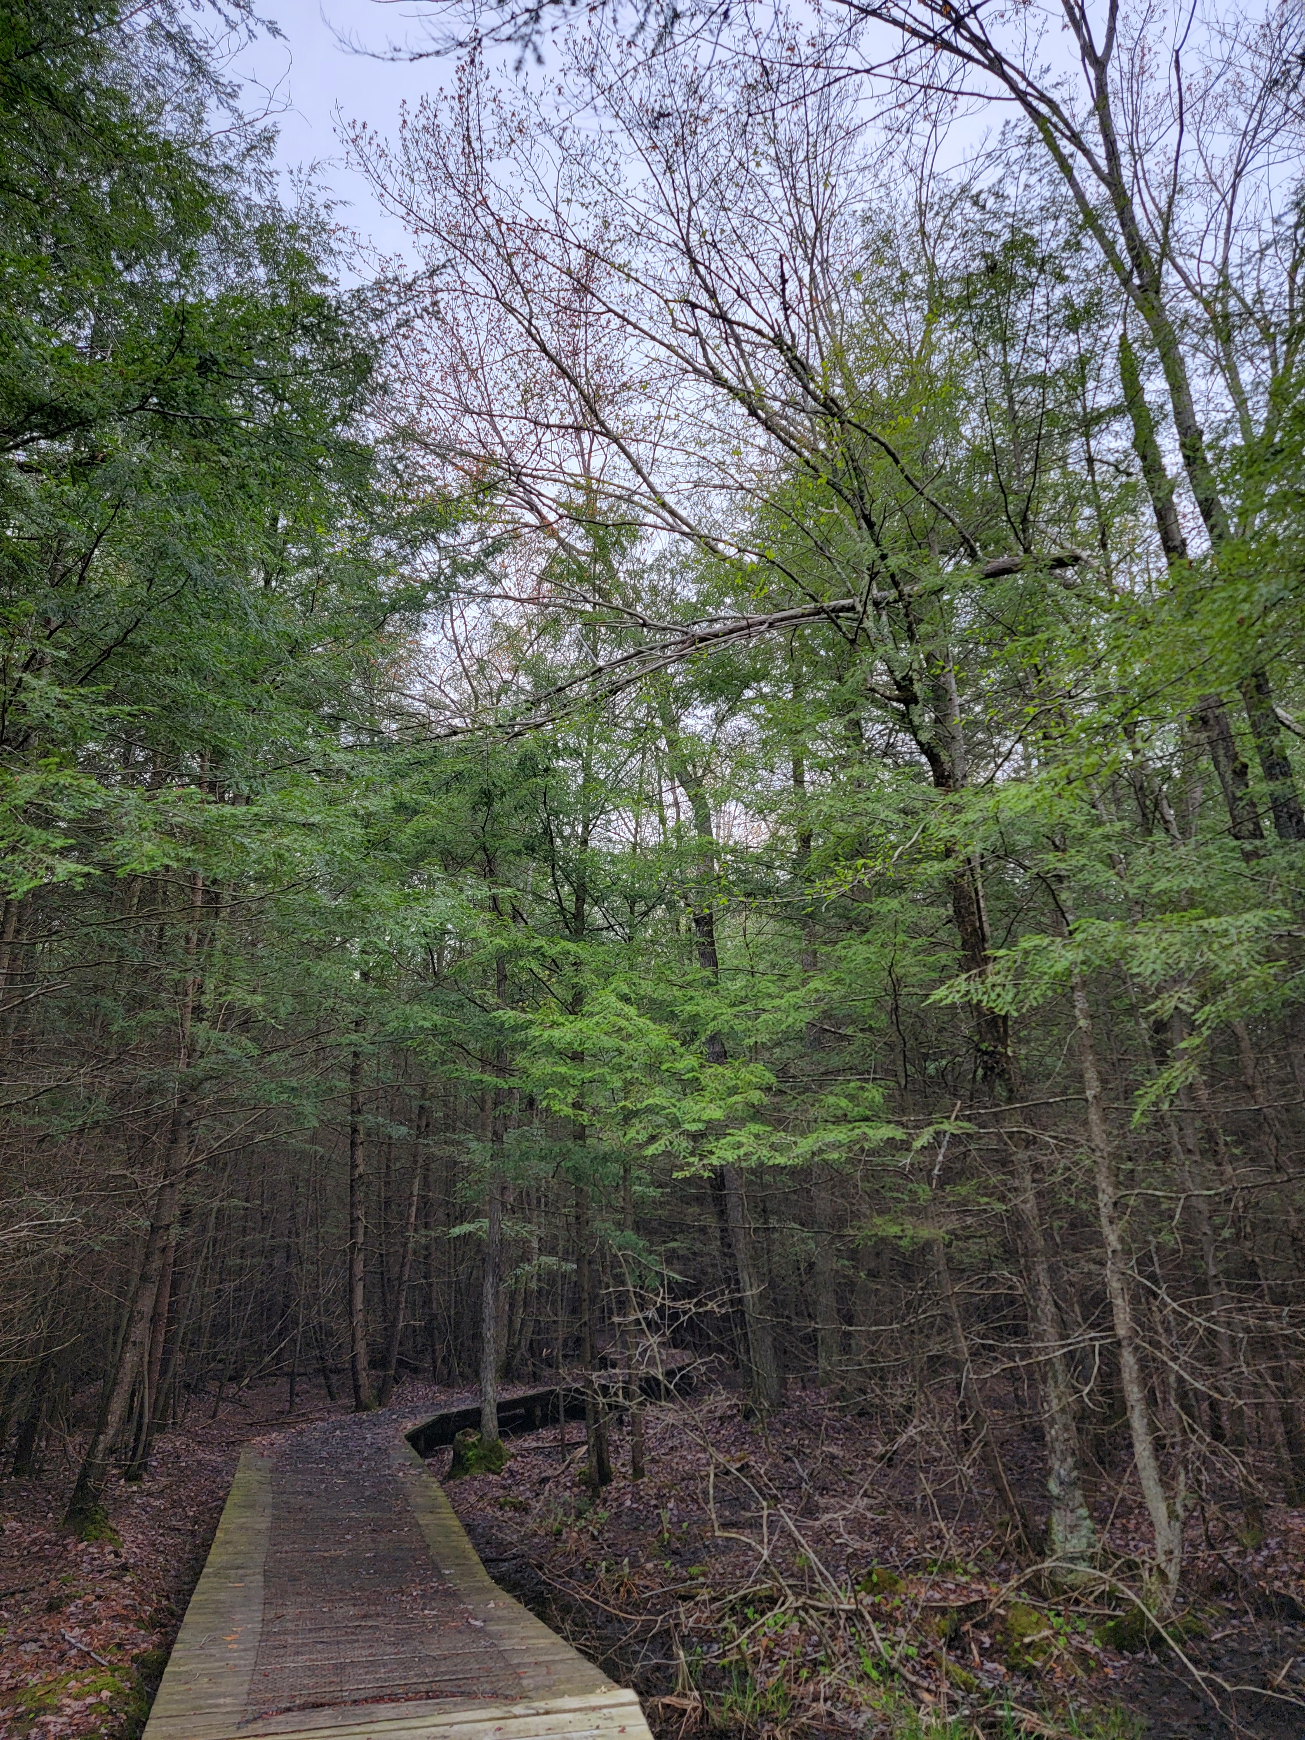
Why should I care about birding?

Slide 4
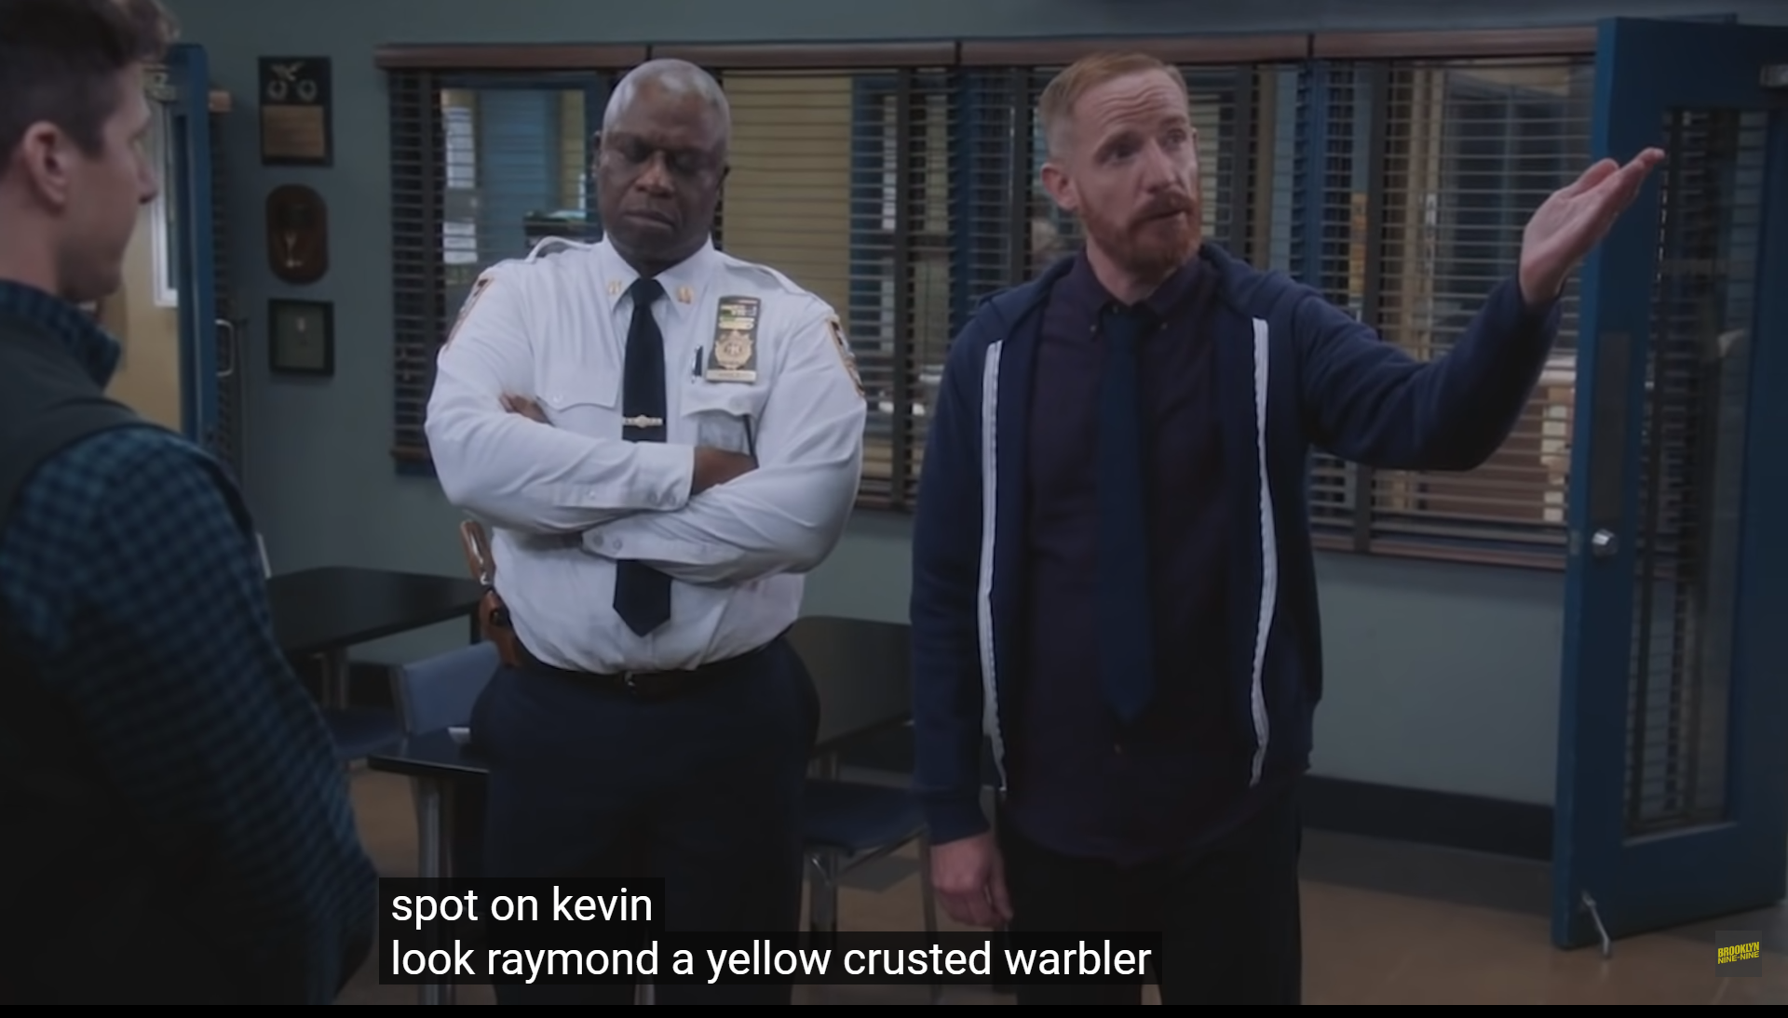

Slide 5
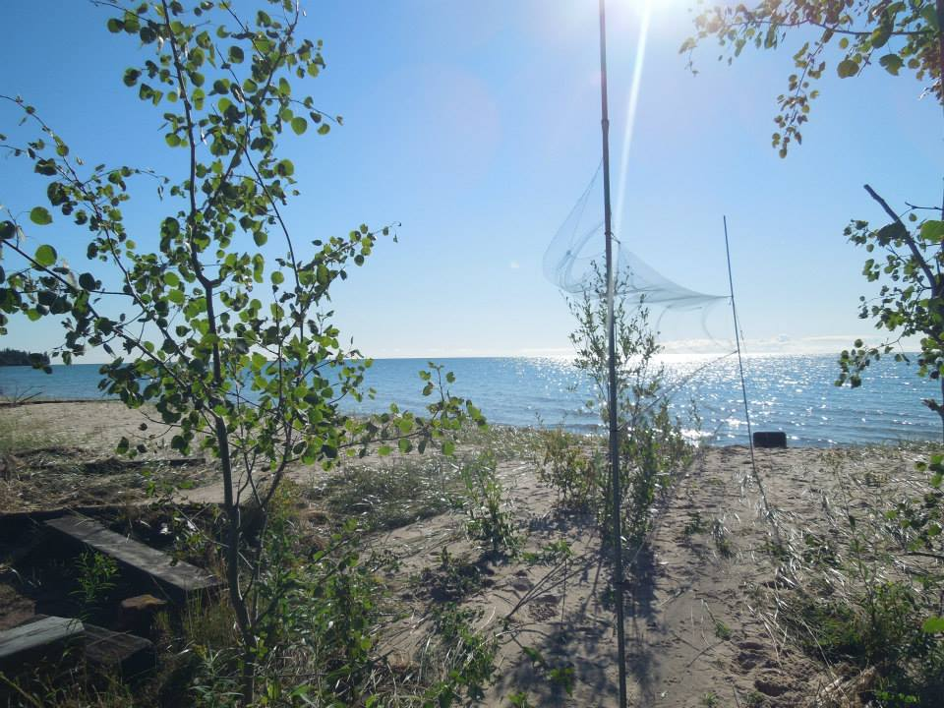
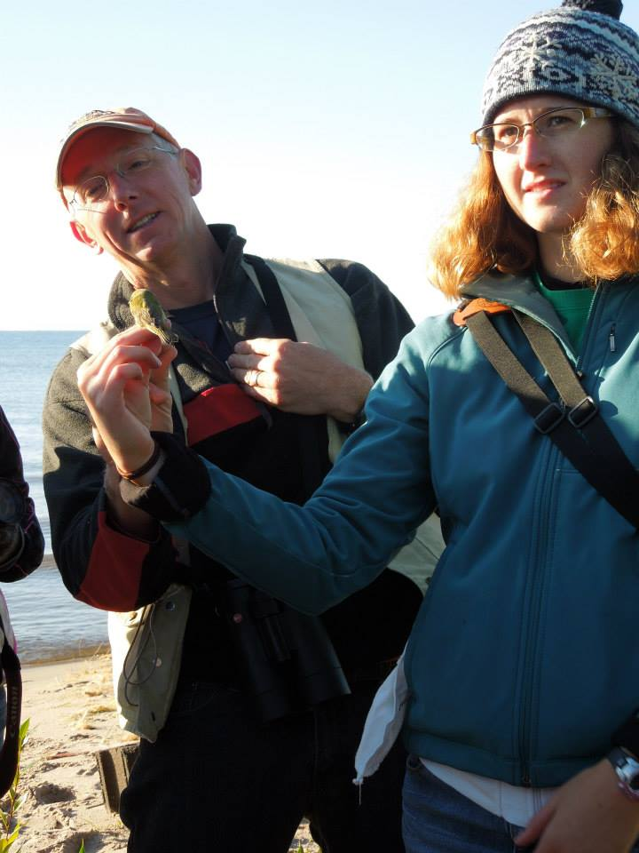
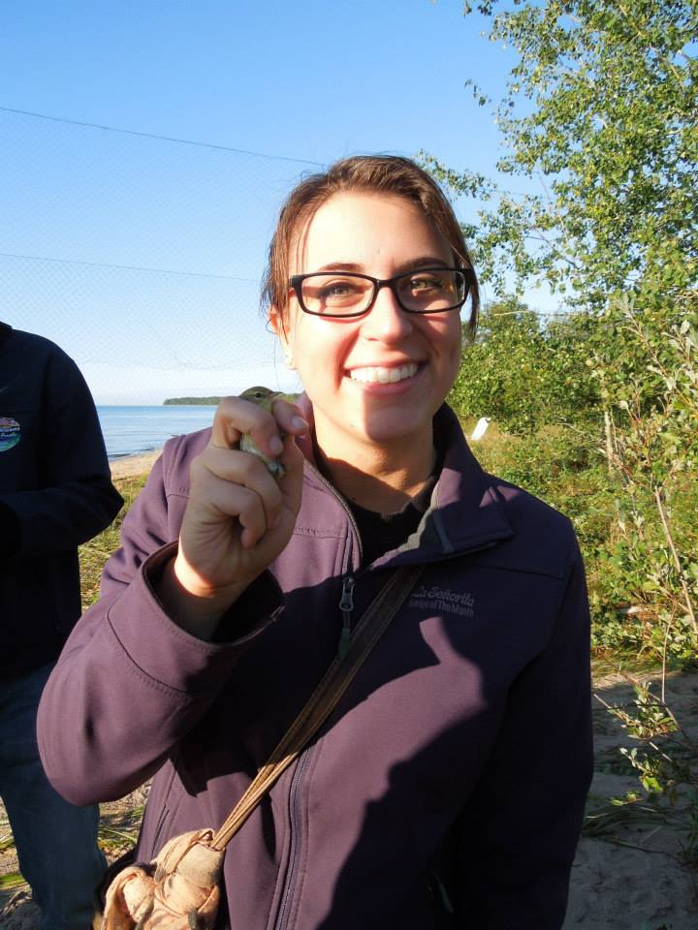
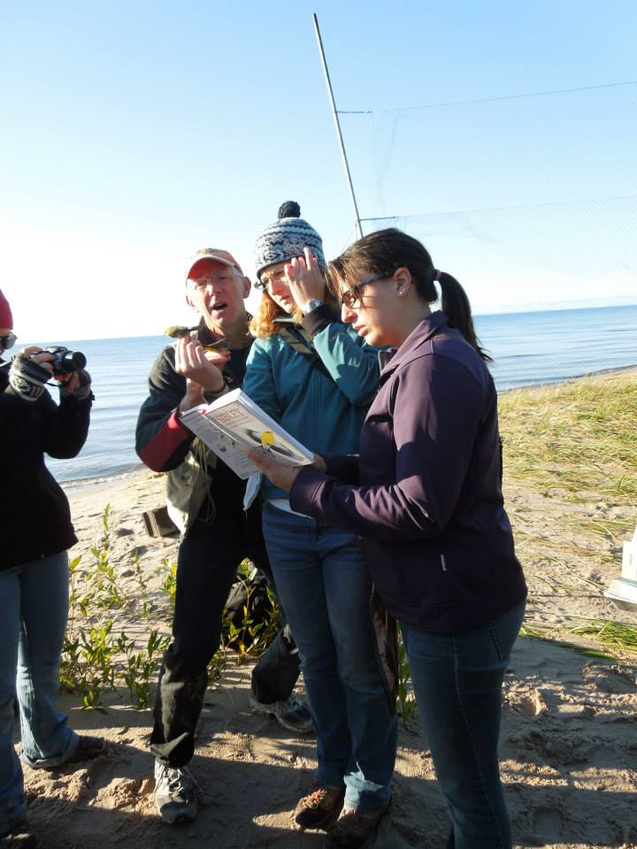
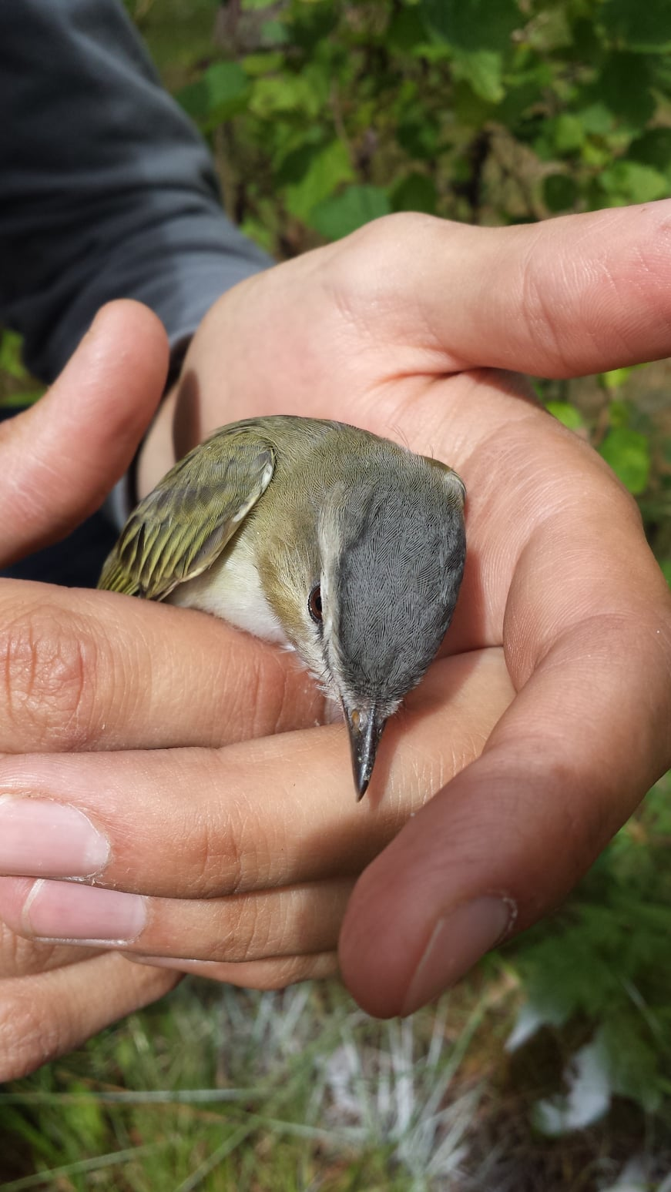
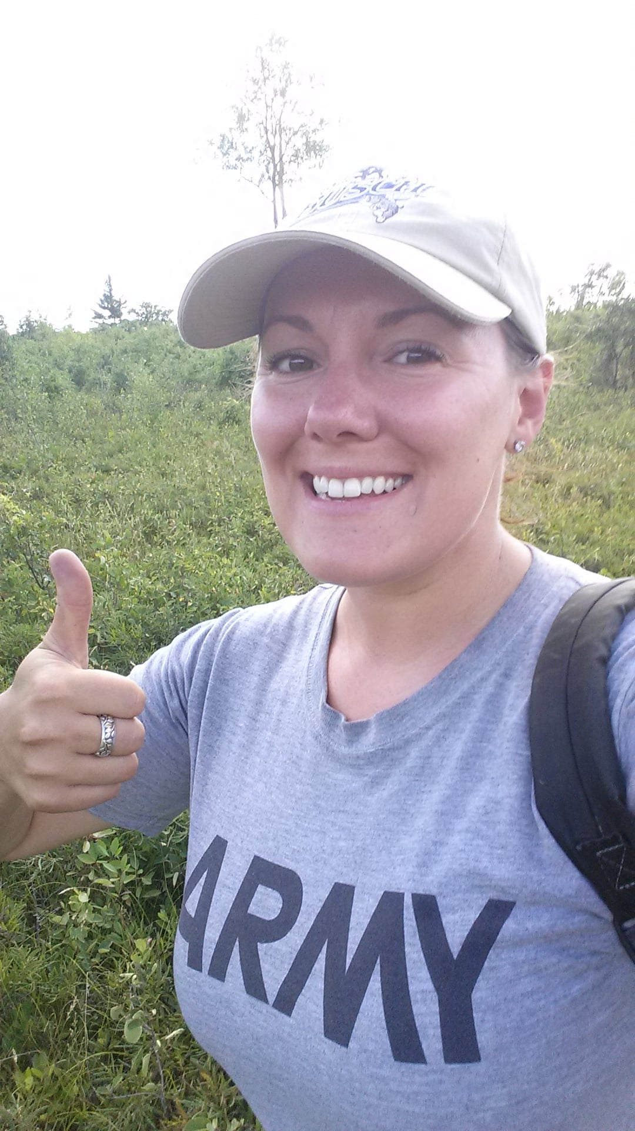

Slide 6
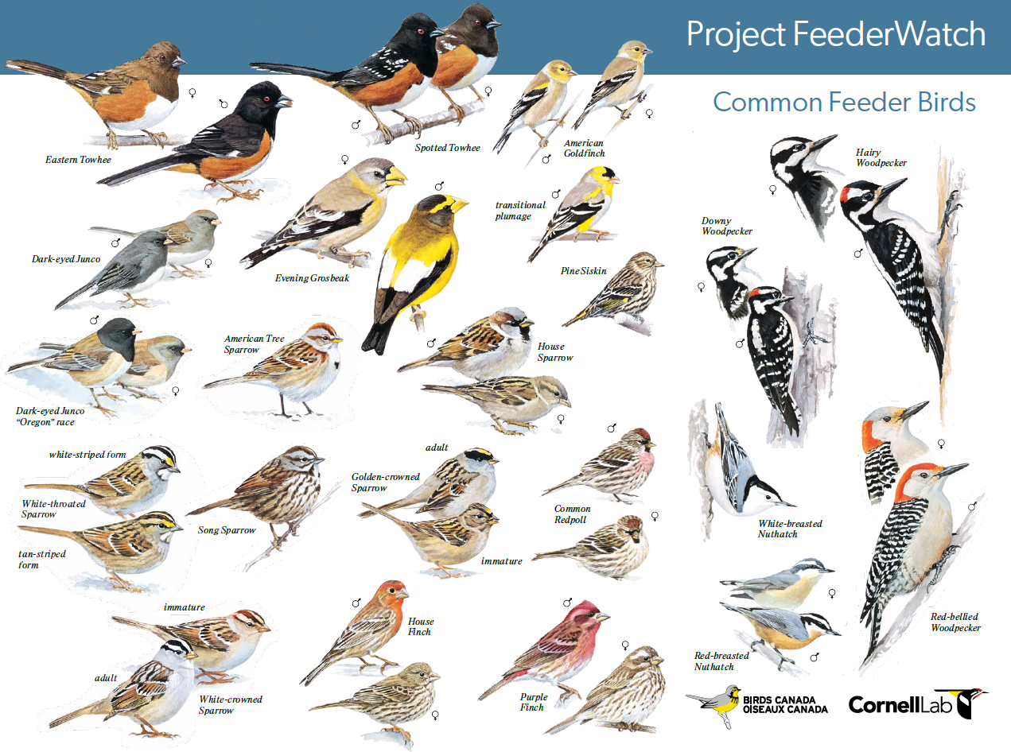
What am I looking for?
Color
Size
Head and Beak
Wings and Tails
Others: movement, flying pattern, foraging behavior

Slide 7
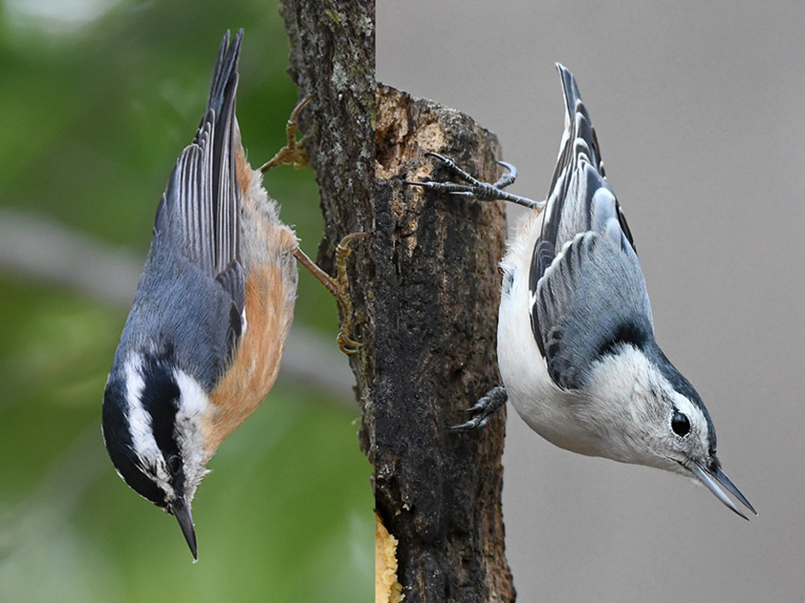
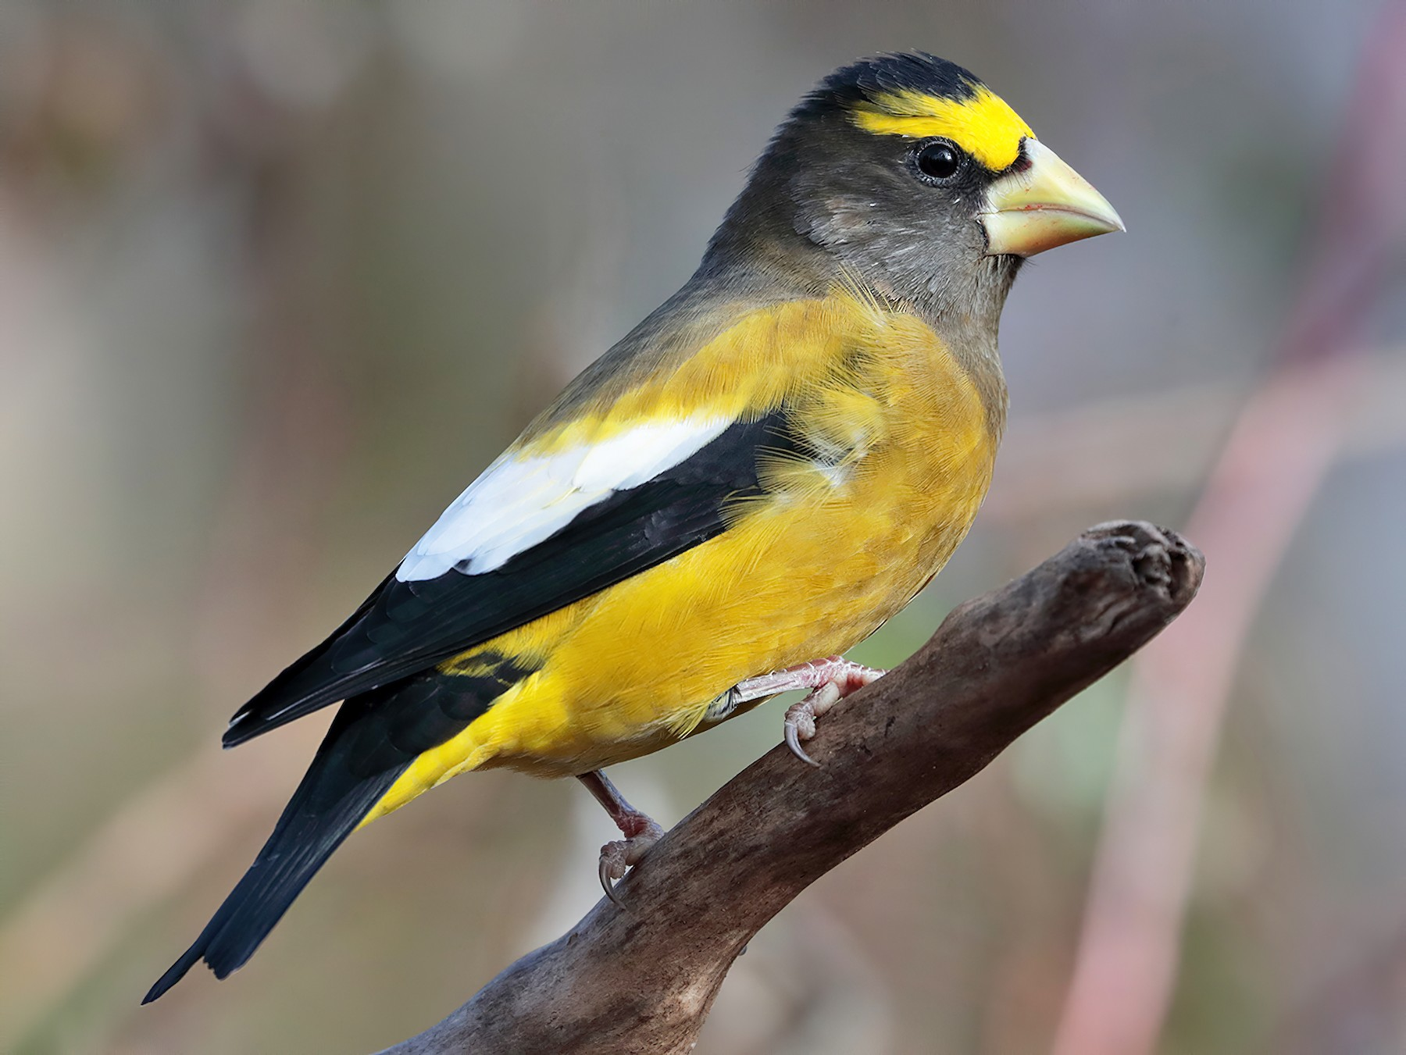
Color

Slide 8
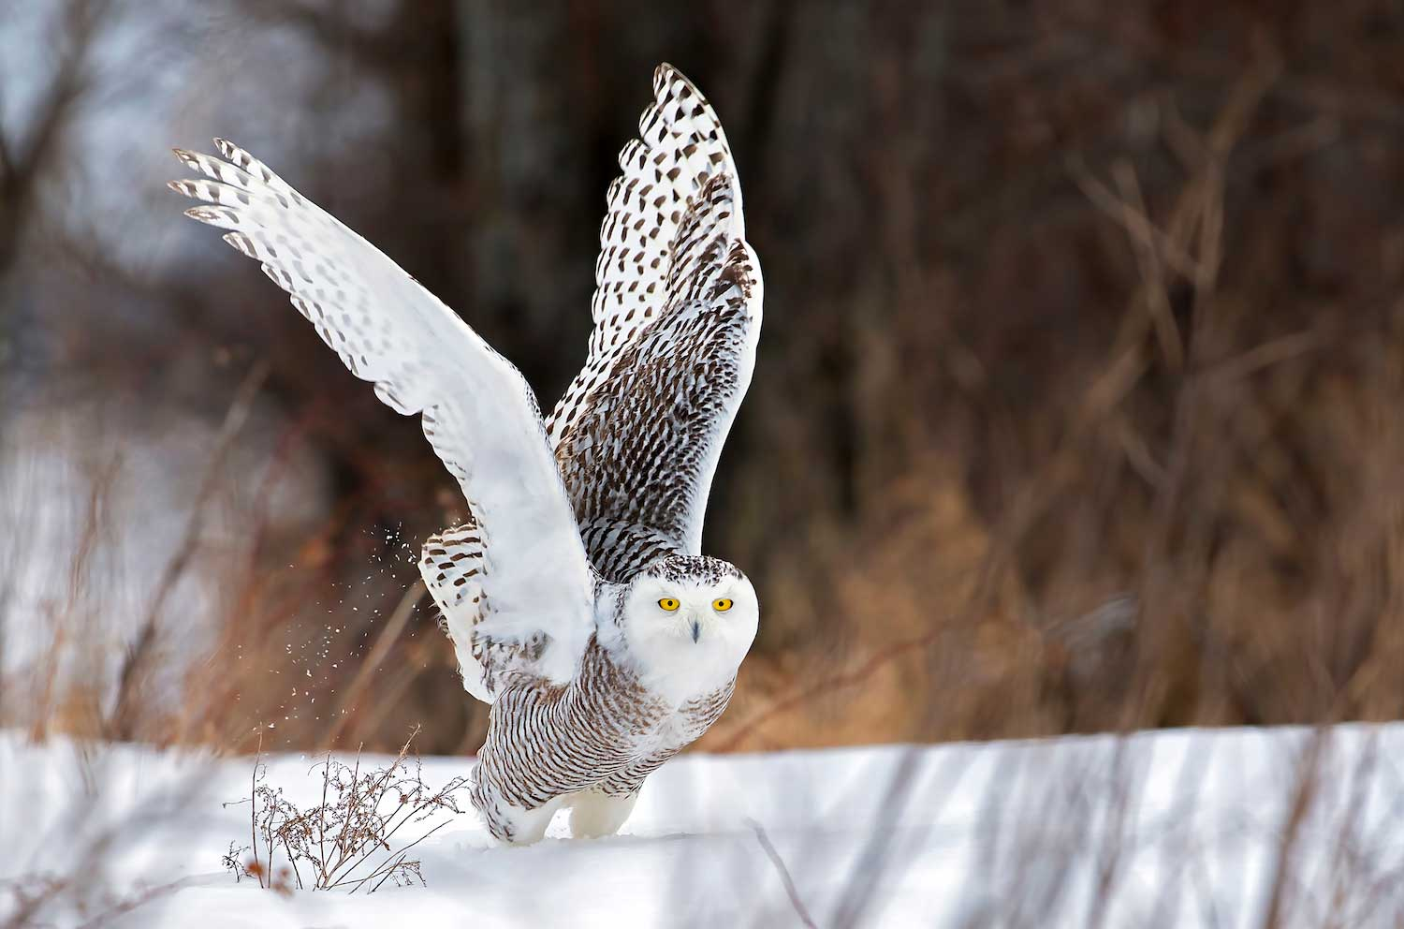
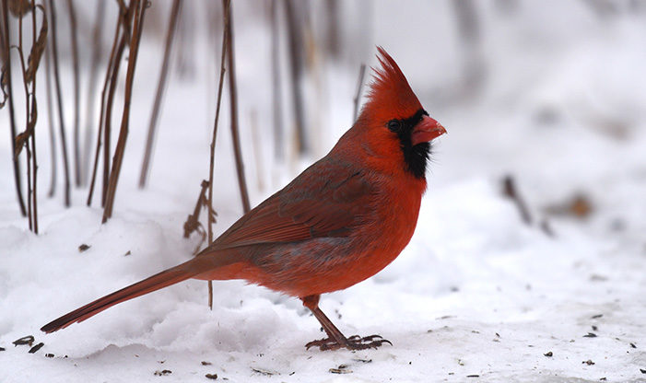
Size

Slide 9
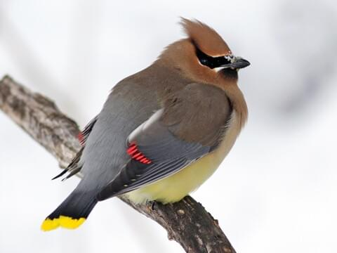
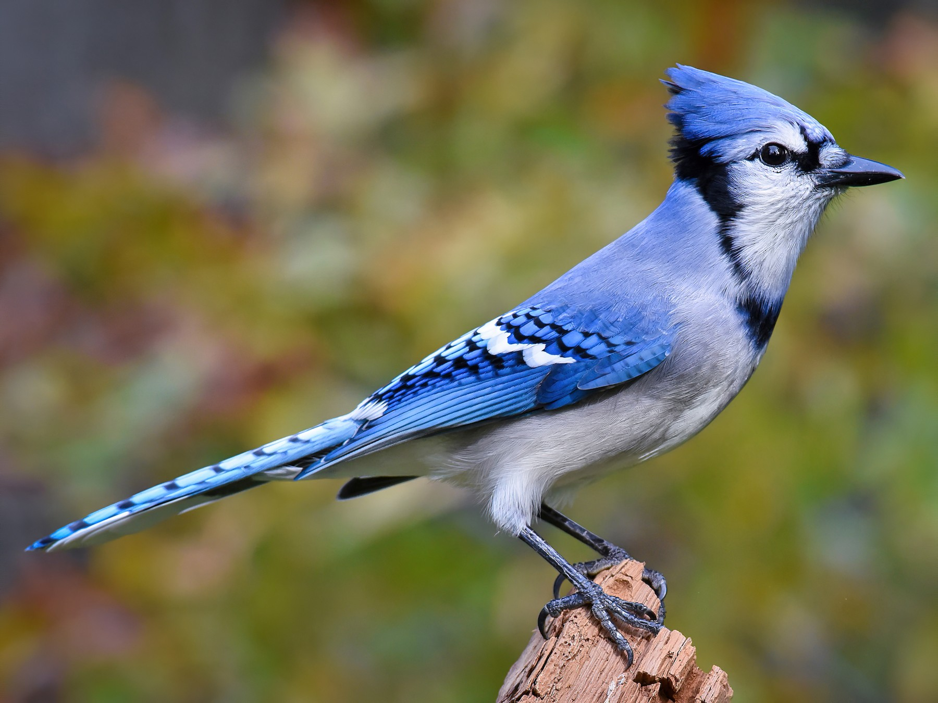
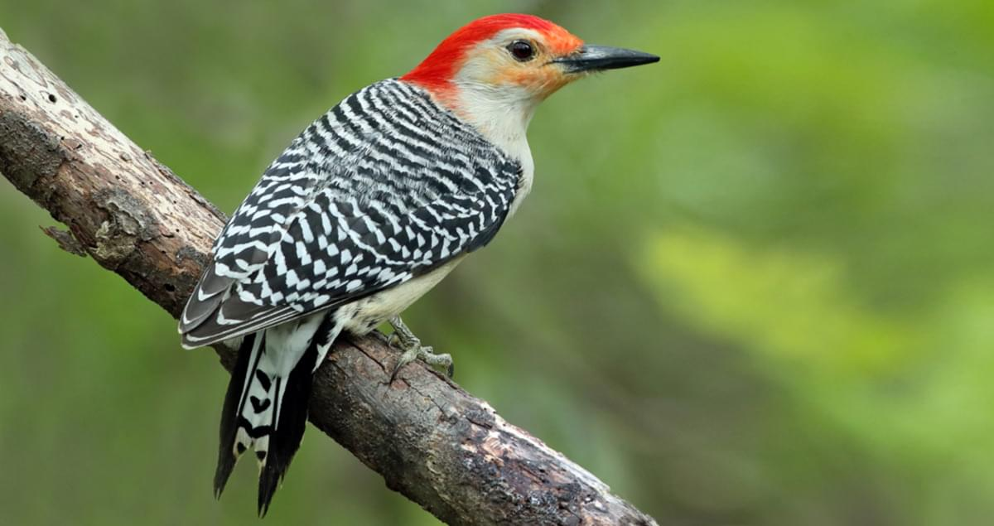
Head

Slide 10
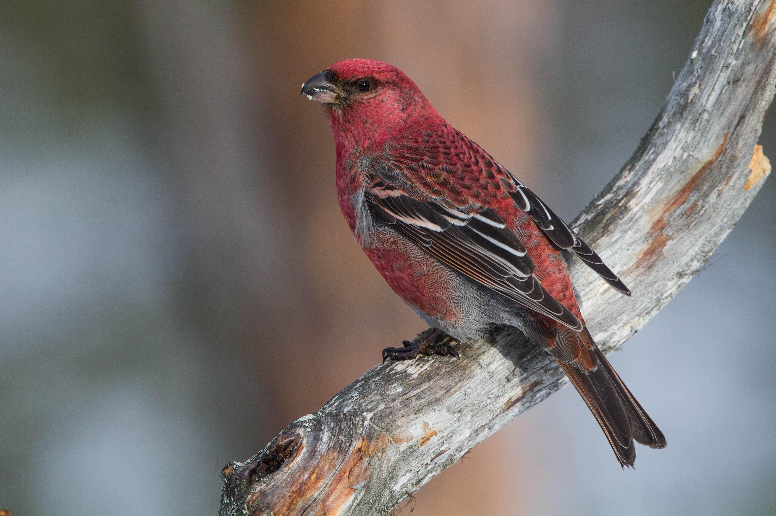
Beak

Slide 11
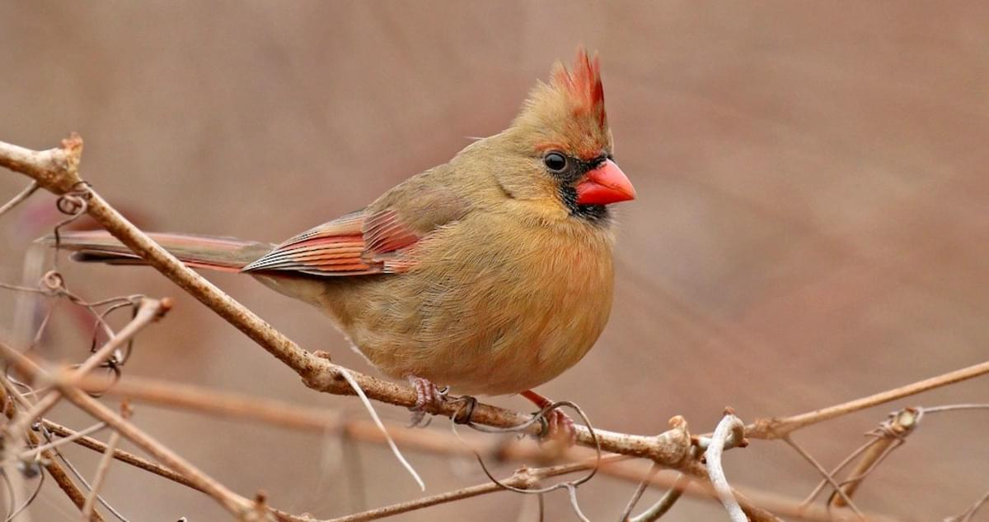
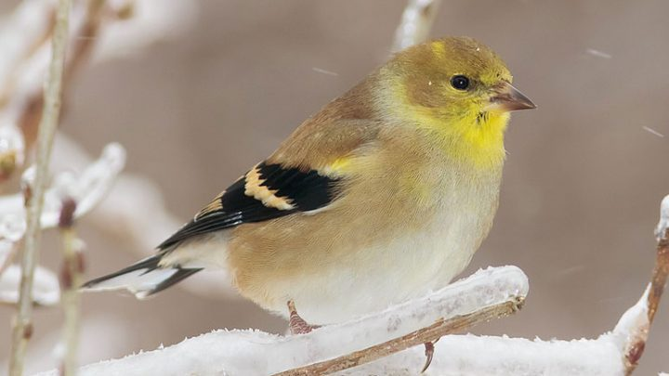

Slide 12
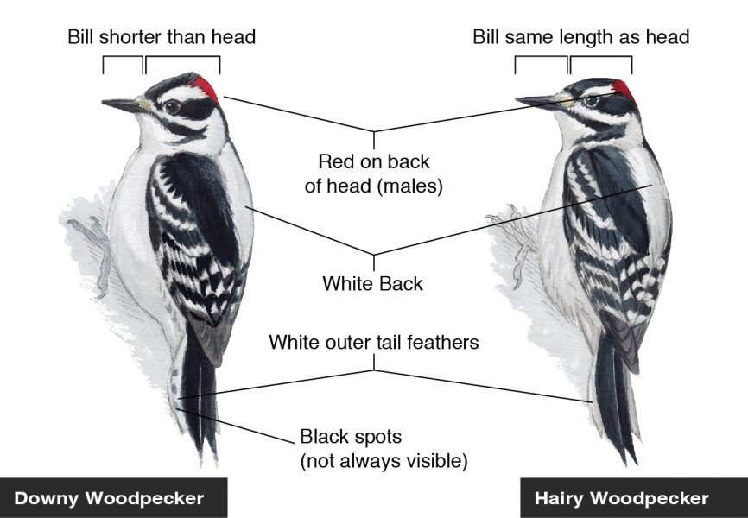

Slide 13
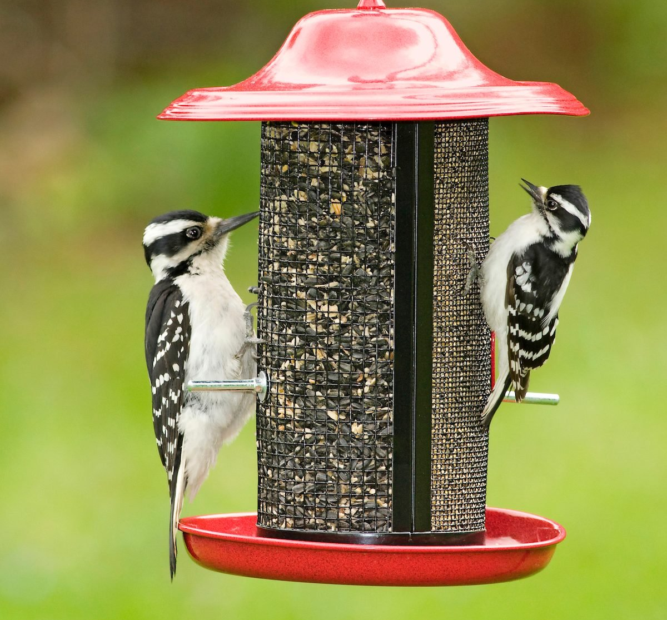

Slide 14
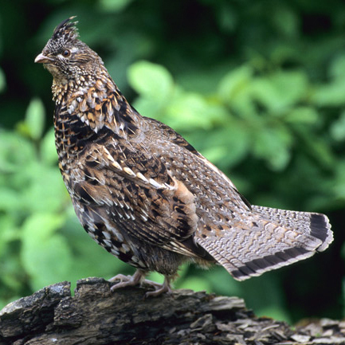
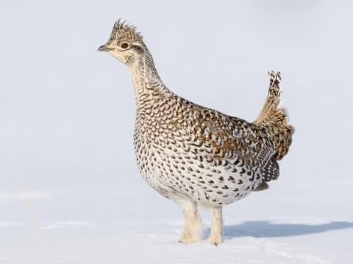
Tails and Wings

Slide 15
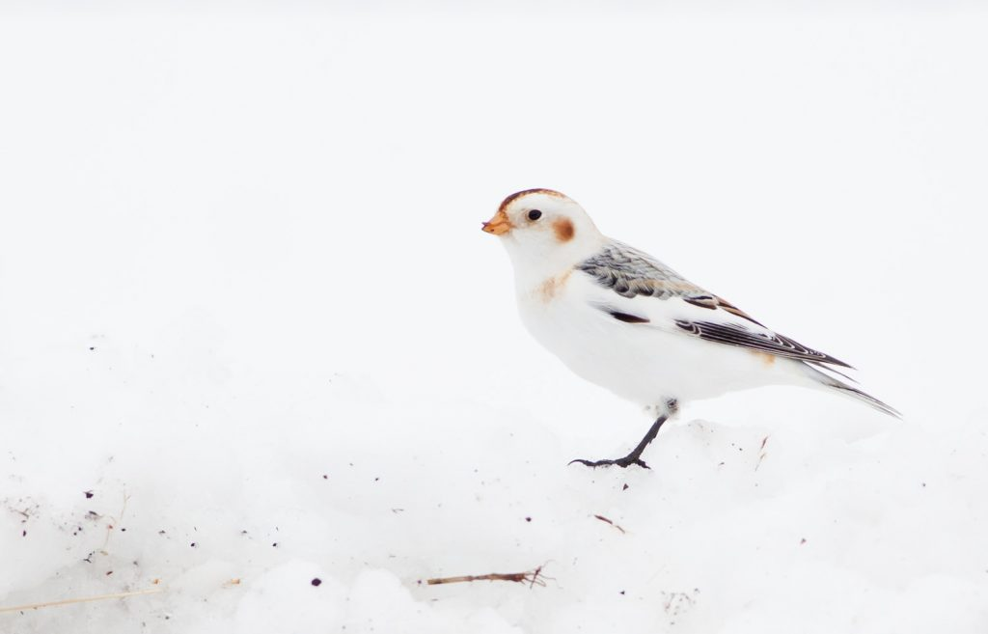
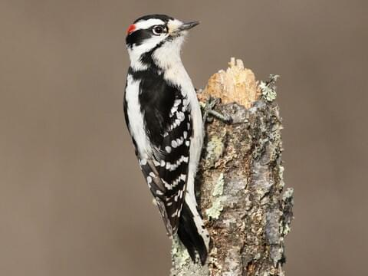

Slide 16
Tools you can use:
Binoculars
Books
Friends
Birding Guides
Smartphone apps
e-Bird
Merlin

Slide 17
Resources
All About Birds: https://www.allaboutbirds.org/news/
Bird Academy: https://academy.allaboutbirds.org/live-events/
Birds and Blooms: https://www.birdsandblooms.com/
American Bird Conservancy: https://abcbirds.org/
Forestry for Michigan Birds: https://www.michiganaudubon.org/our-conservation-impact/forestry-for-michigan-birds/
Michigan Audubon: https://www.michiganaudubon.org/
E-bird https://ebird.org/home
Merlin bird ID app https://merlin.allaboutbirds.org/

Slide 18
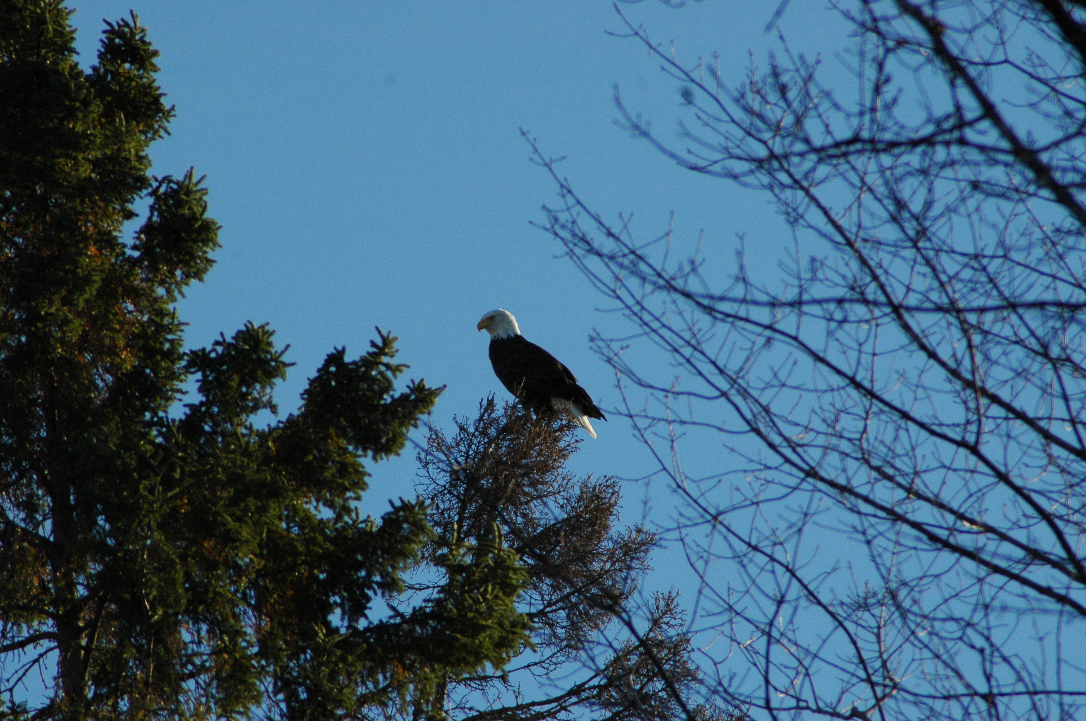
Christmas Bird Count and Great Backyard Bird Count
Christmas Bird Count – this Saturday, December 16
7.5 mile radius from end of Krummich Road, can count at home or be assigned a location
Contact Ron Annelin at rannelin@charter.net
Great Backyard Bird Count
February 16-19 2024
Keep an eye out for SCD group event
https://www.birdcount.org/

Slide 19
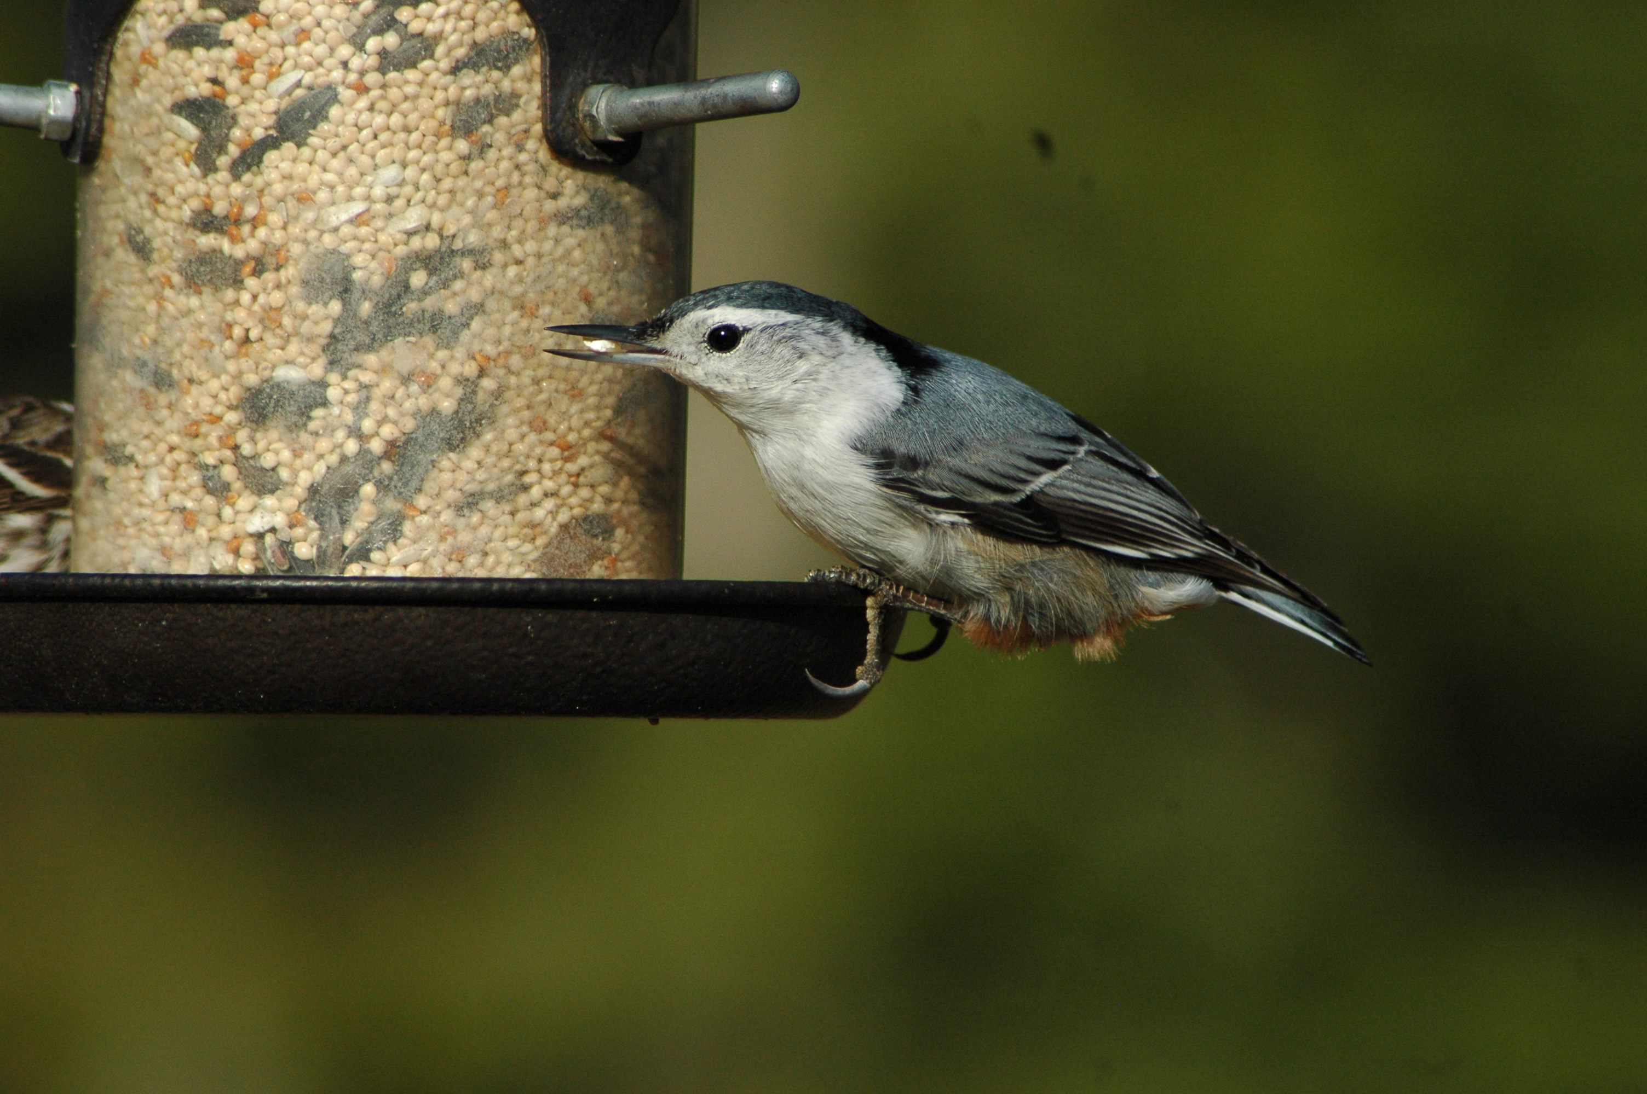
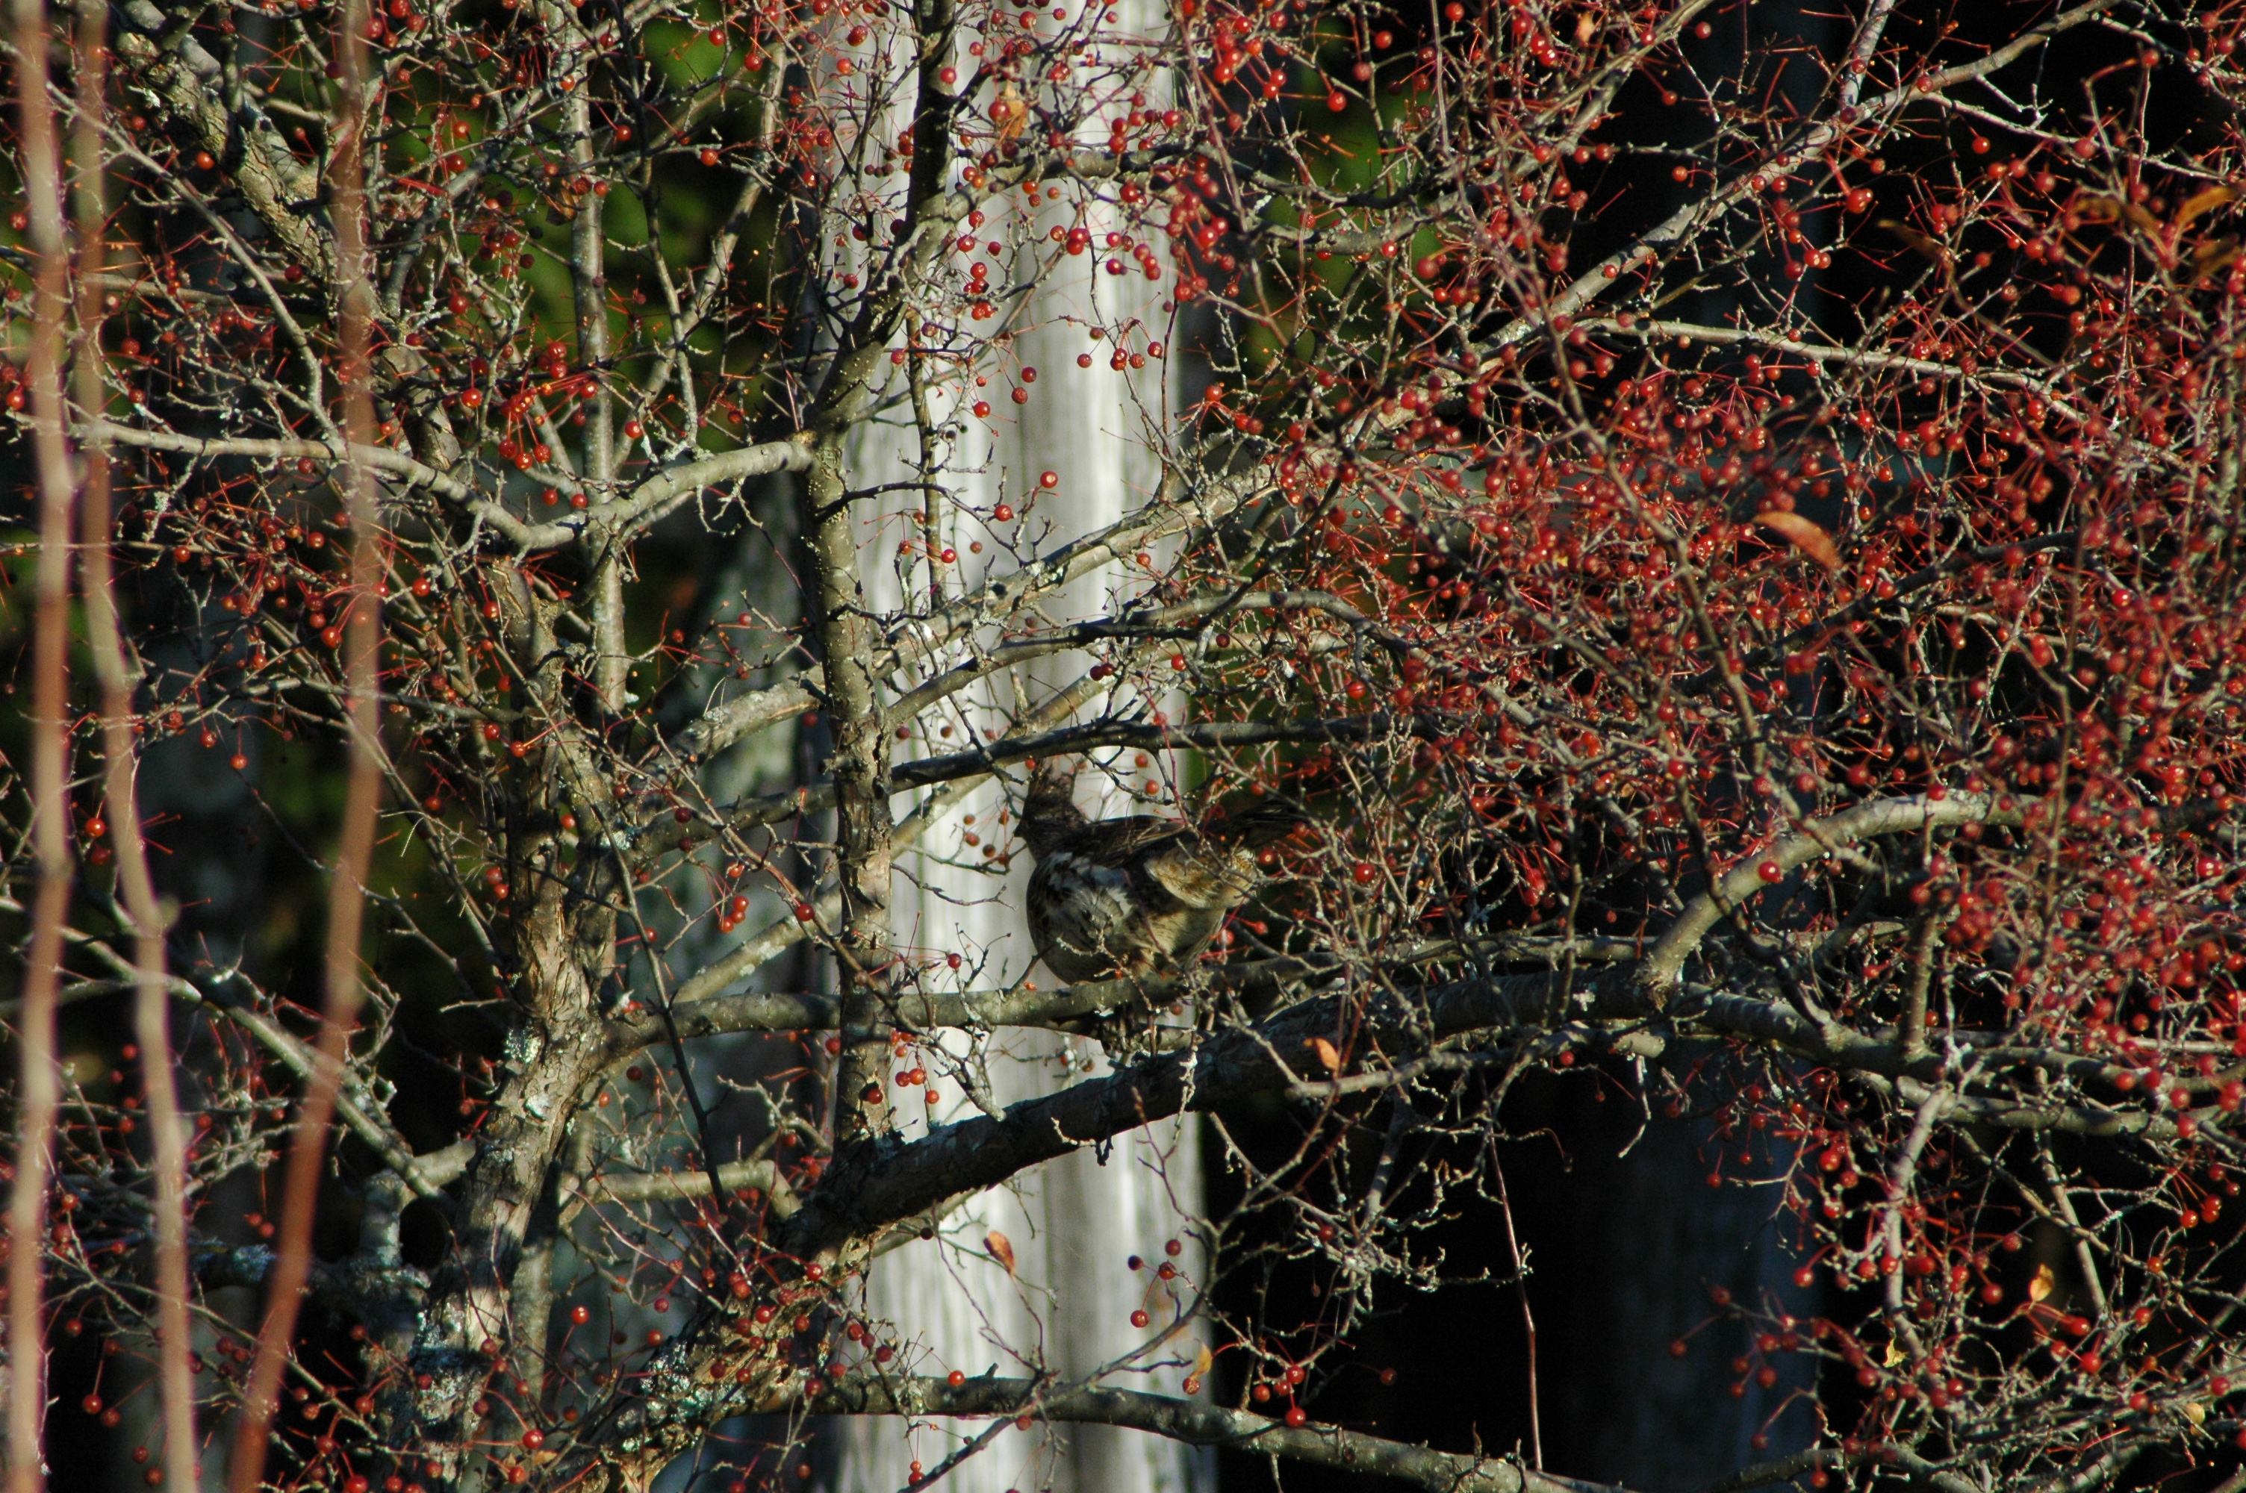
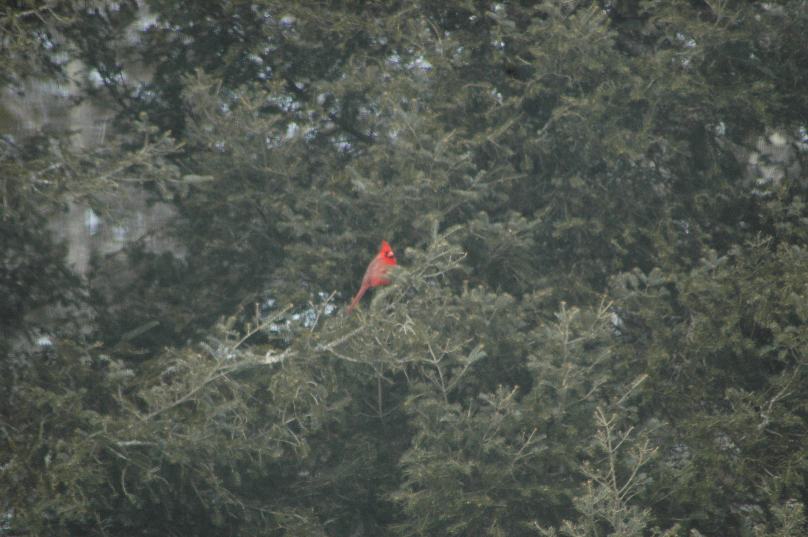
Bird Habitat and Bird Feeders
Adding habitat to your yard:
Cover
Nesting locations
Food sources
Bird Feeders:
Different types for different species
What types of food?
Cleanliness/Messiness
Water sources

Slide 20
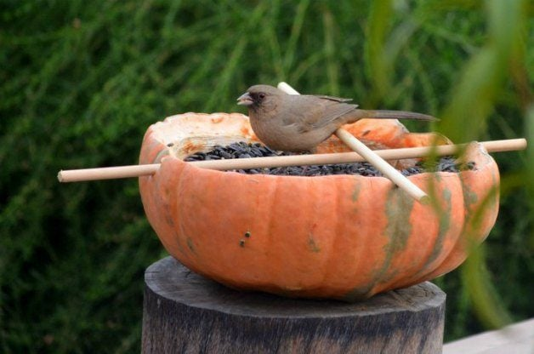
Make your own!

