Slide 1
Native Plant Gardens
Schoolcraft Conservation
District

Slide 2
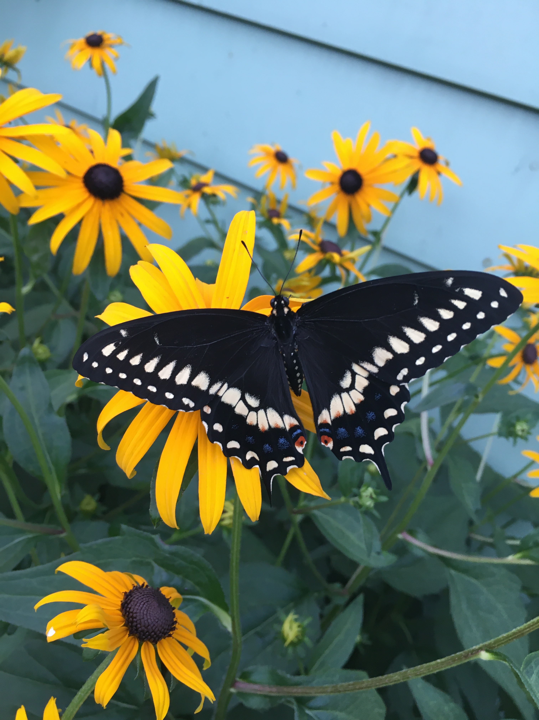
What are native plants?
Pollinator benefits
How to select plants for your garden
Animals, pests, mulch, and weeds
Invasive species
A realistic approach
Questions/advice

Slide 3
What are native plants?
“Native plants are the indigenous terrestrial and aquatic species that have evolved and occur naturally in a particular region, ecosystem, and habitat. Species native to North America are generally recognized as those occurring on the continent prior to European settlement.” US Forest Service

Slide 4
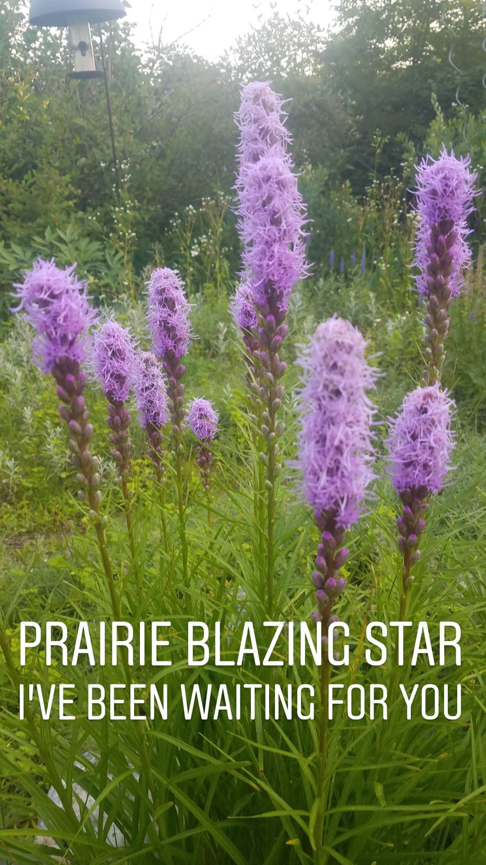
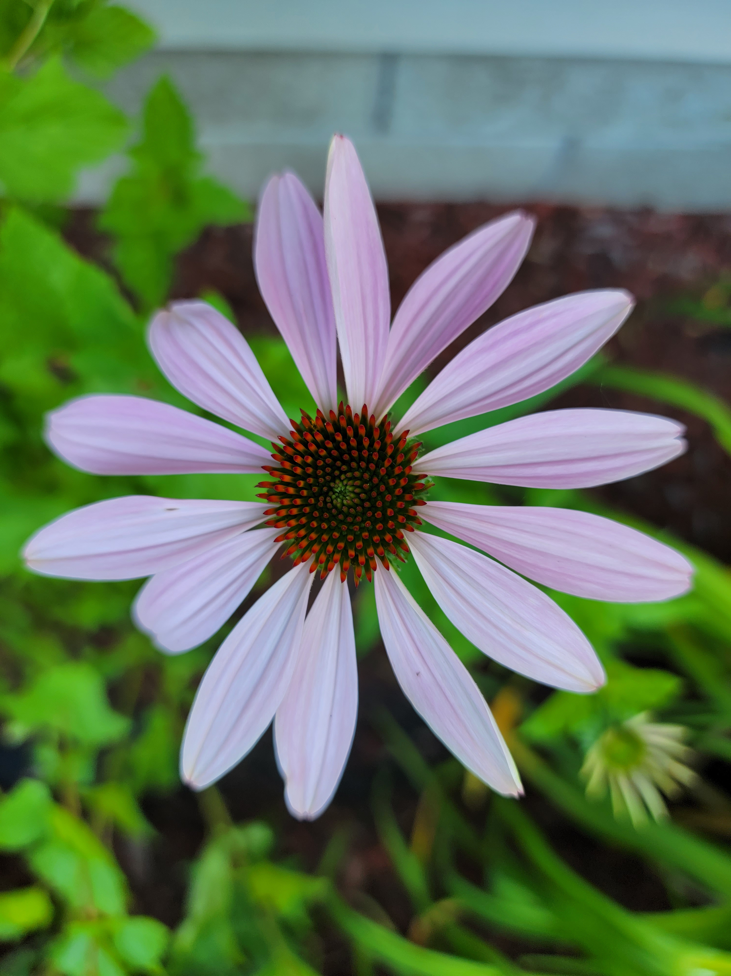
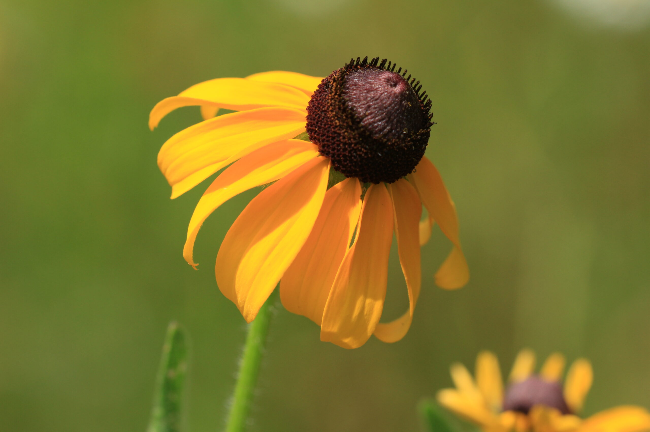

Slide 5
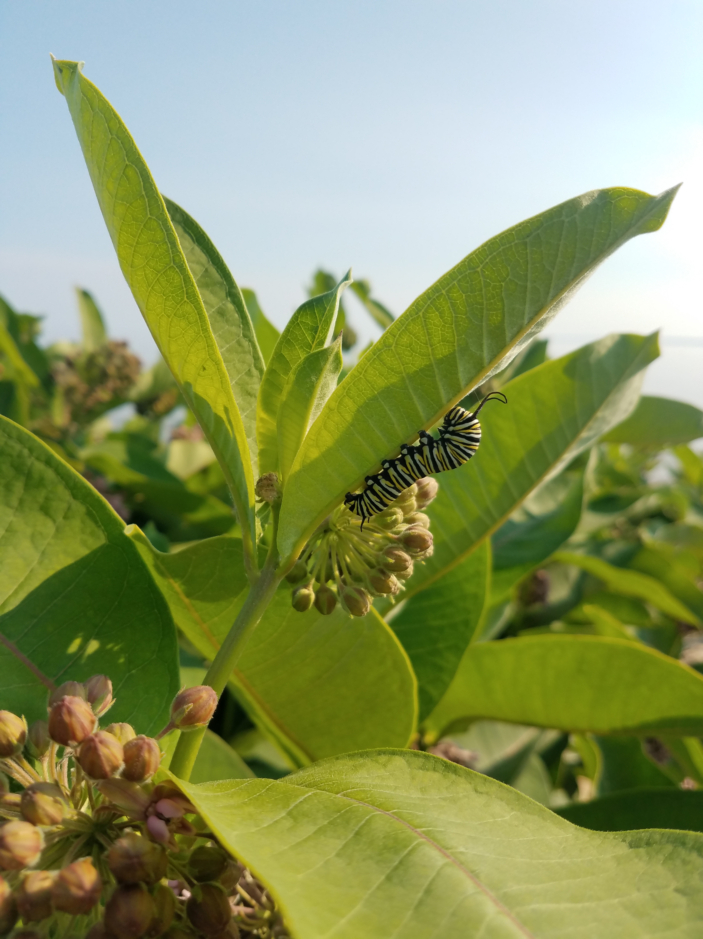
Why Native Plants?
Enhance native biodiversity
Less likely to be invasive
Adapted to our local climate
Support pollinators and the native food web
Soil health and erosion control

Slide 6
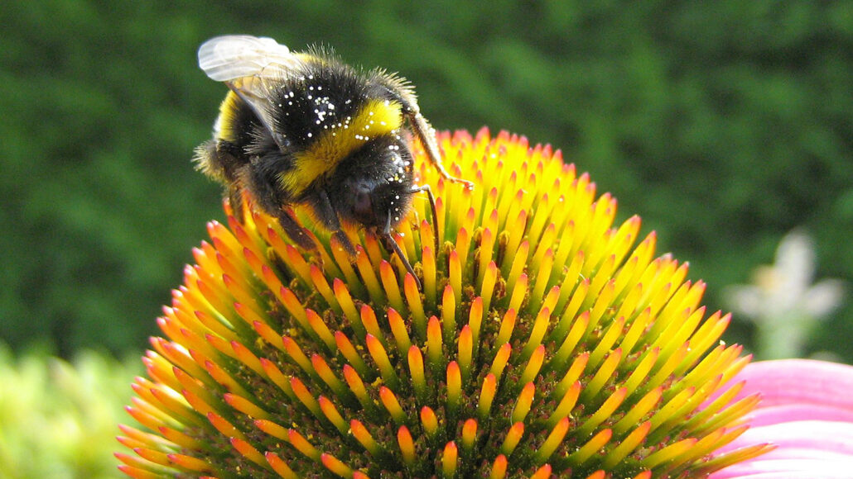
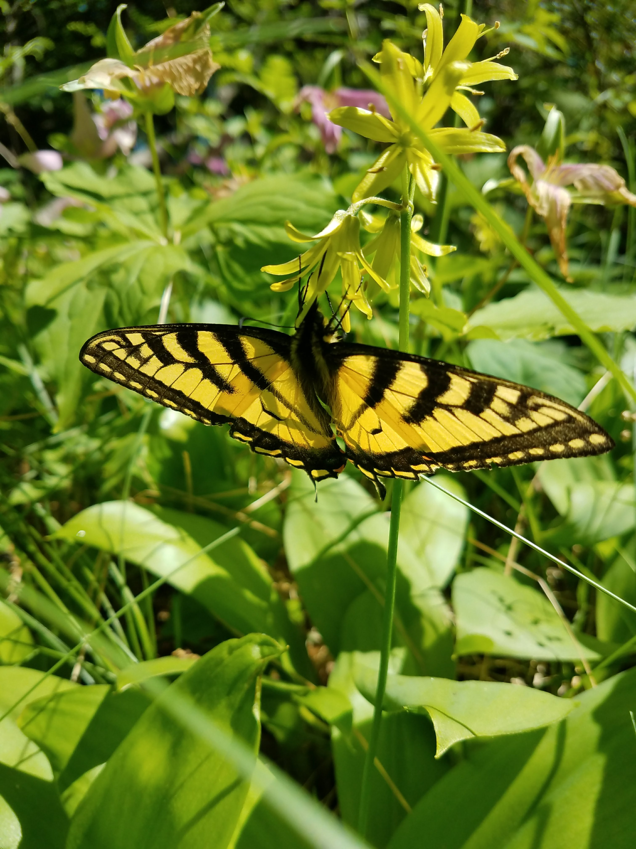
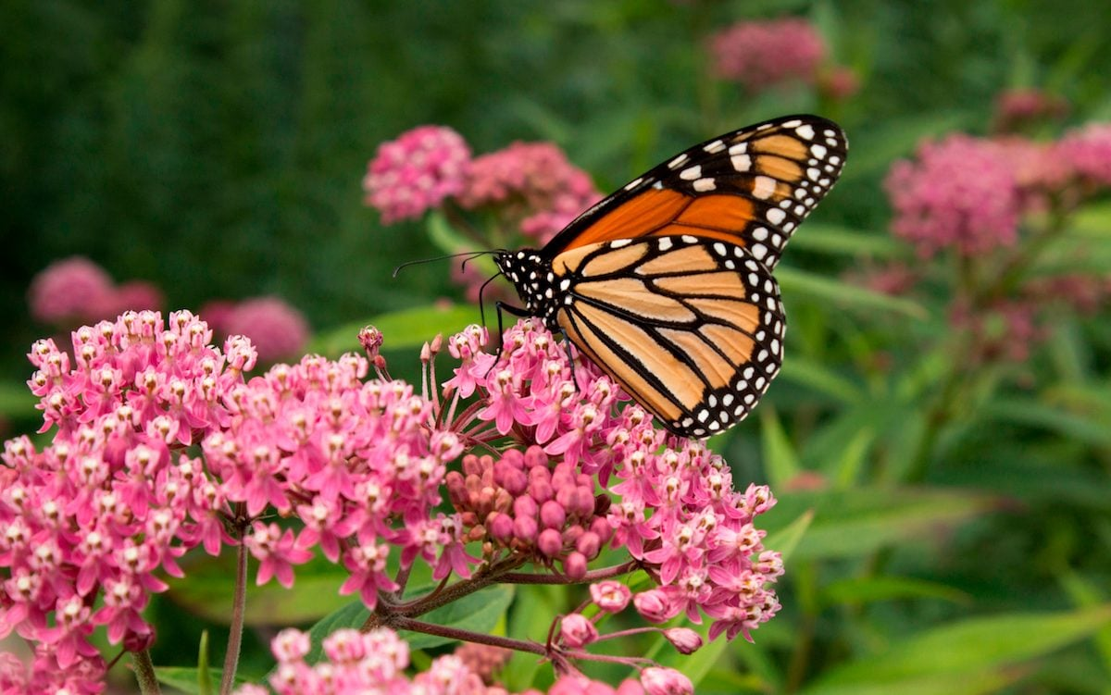

Slide 7
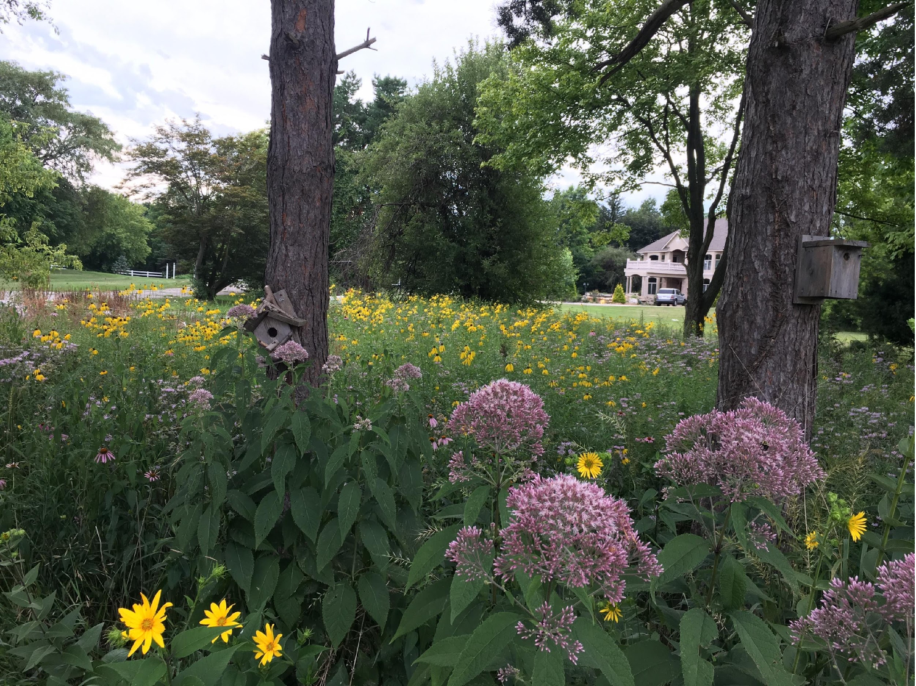
How to select plants for your garden:
What do you already have?
What are the conditions of your site?
Is it … dry, wet, seasonally wet?
sun, shade, partial sun? soil type – sandy, clay?
What is the size of the area you want to plant?
What do you need to do to prepare your site?

Slide 8
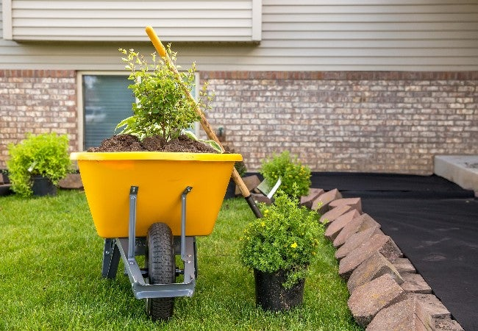
Site Preparation
Removing existing vegetation
Tilling
Removal
Suppress – sheet mulching, plastic or boards
Add landscape fabric?
Nutrient needs
Organic matter – compost, soil
Fertilizer

Slide 9
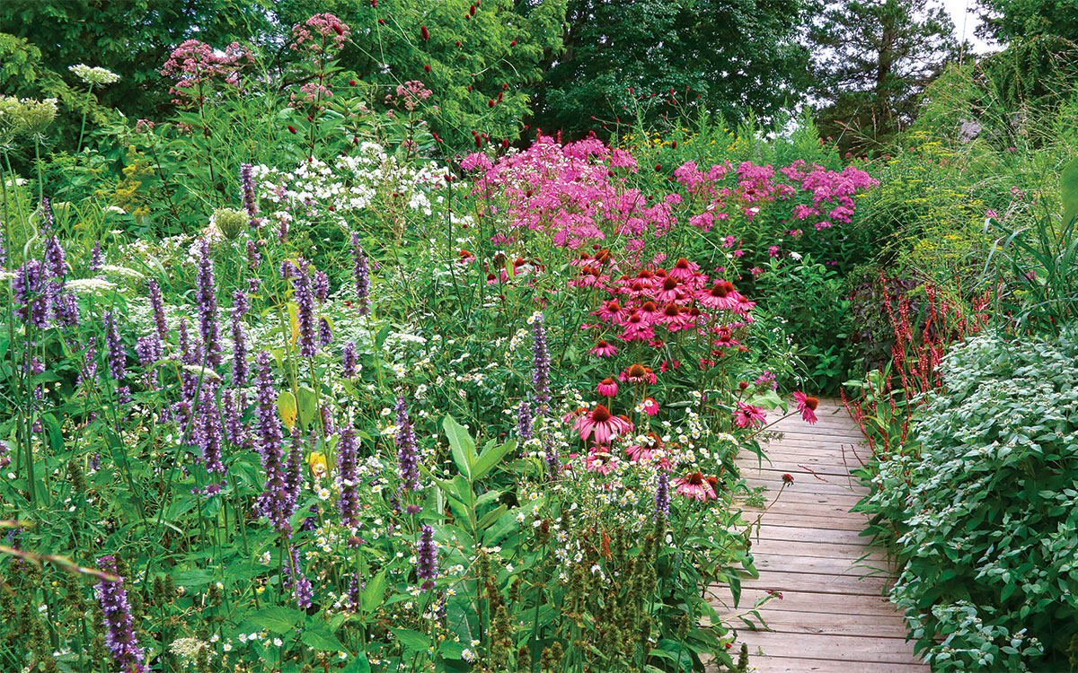

Slide 10
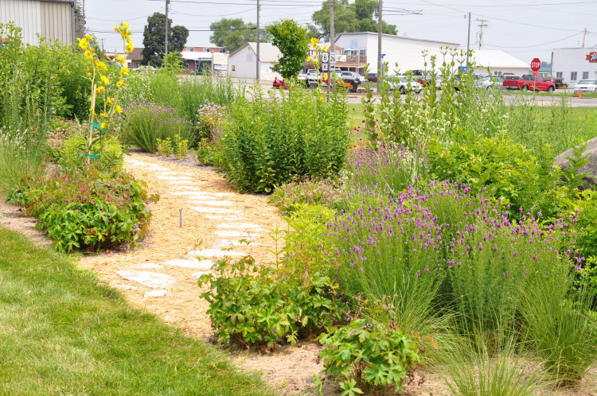

Slide 11
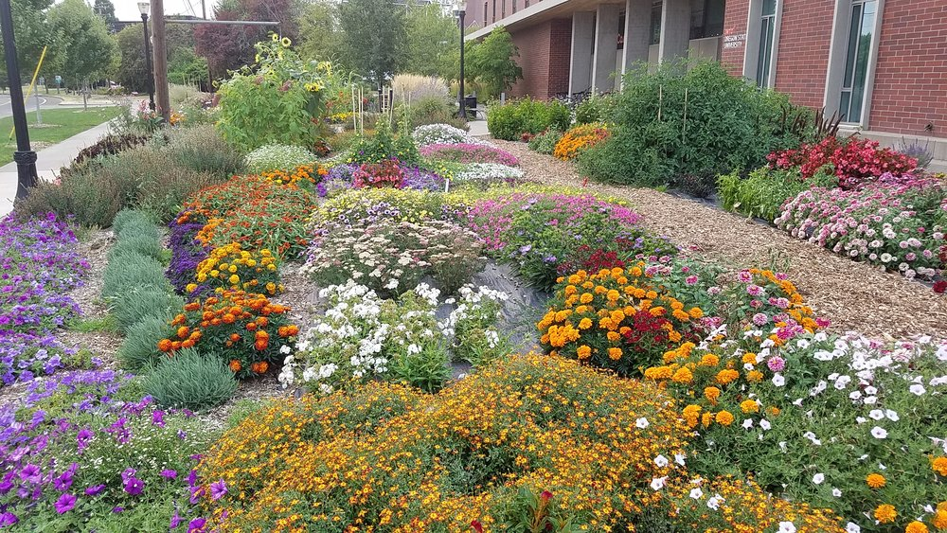

Slide 12
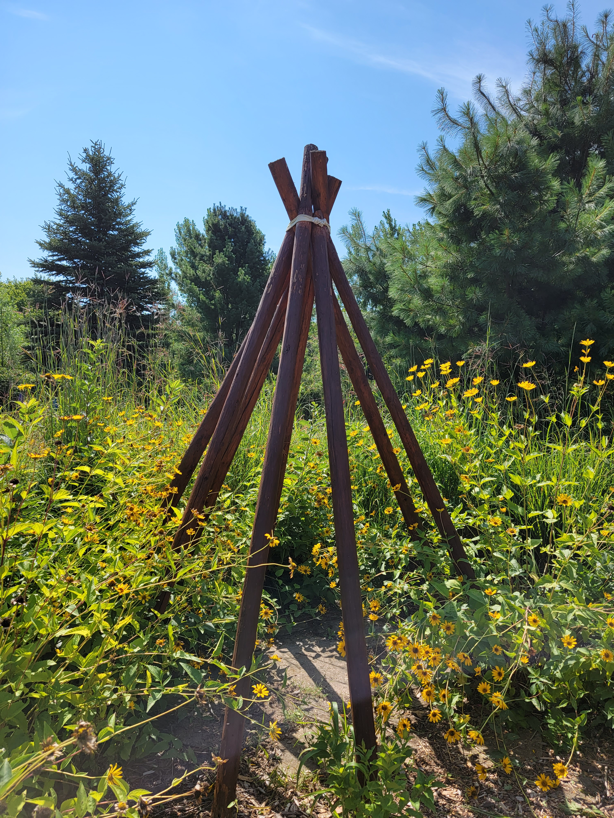

Slide 13
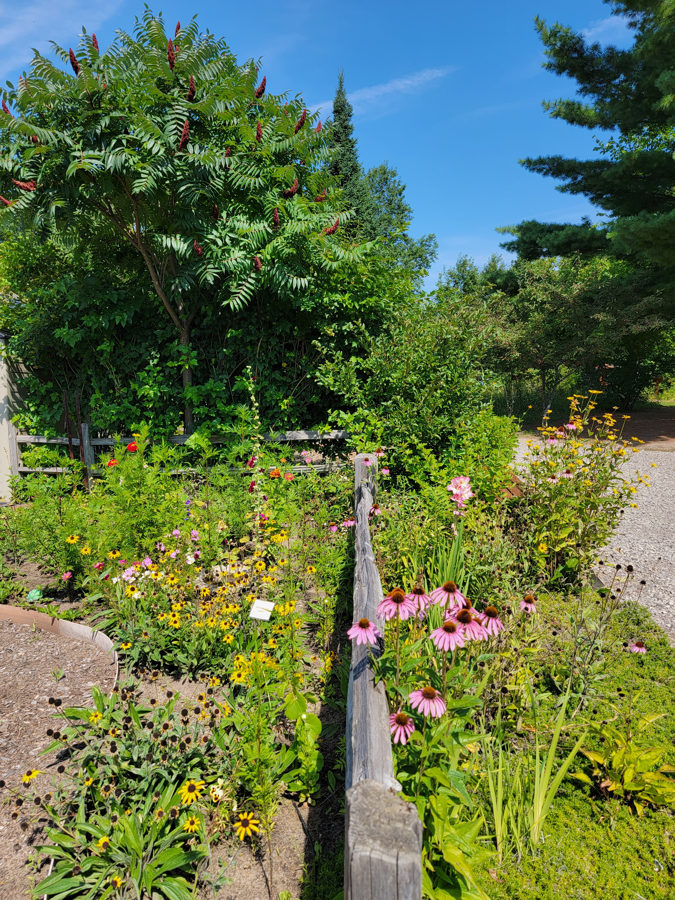

Slide 15
Plants For Pollinators
Short:
● Blazing Star
● Butterfly Weed
● Sand Tickseed
● Black-eyed Susan
● Prairie Smoke
● Jacob’s Ladder
● Wild Geranium
● Prairie Dropseed Grass
Medium:
● Pale Purple Coneflower
● Spiderwort
● Great Blue Lobelia
● Blue Iris
● Foxglove Beardtongue
● Little Bluestem Grass
Tall:
● Blue Vervain
● Milkweed
● Purple Coneflower
● Gray-headed Coneflower
● Brown-eyed Susan
● Wild Bergamot
● White Turtlehead
Shrubs:
● Ninebark, Serviceberry, Viburnum

Slide 16
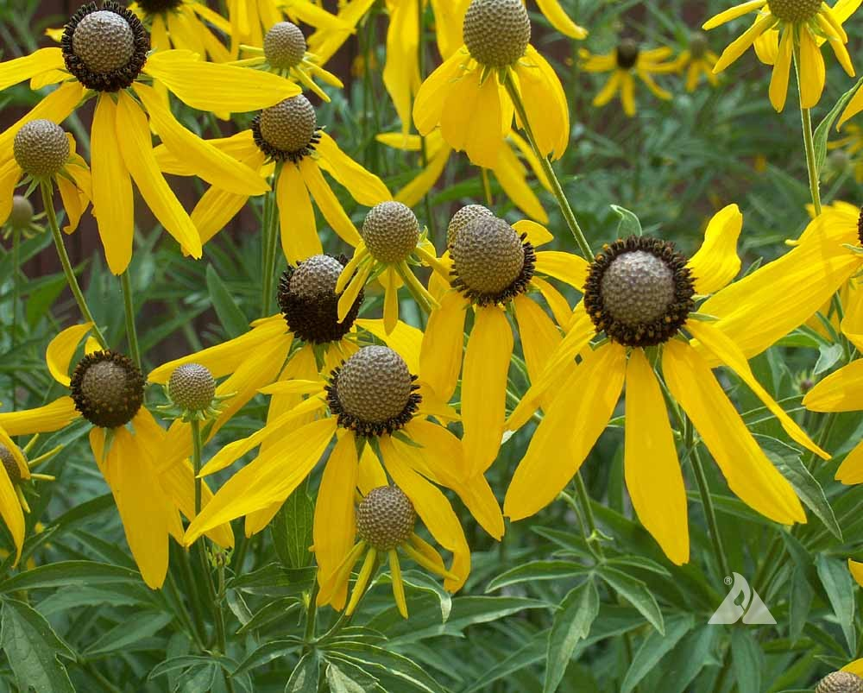

Slide 17
Plants for Dry and Sandy Sites
Short:
● Butterfly Weed
● Black Eyed Susan
● Sand Tickseed
● Thimbleweed
● Prairie Smoke
● Prairie Dropseed Grass
● Prairie Coreopsis
● Columbine
Medium:
● Wild Lupine
● Pale Purple Coneflower
● Spiderwort
● Foxglove Beardtongue
● Little Bluestem Grass
● Bottlebrush Grass
Tall:
● Purple Coneflower
● Gray-headed Coneflower
● Woodland Sunflower
● Big Bluestem Grass
Shrubs:
● Chokecherry, some Viburnums

Slide 18
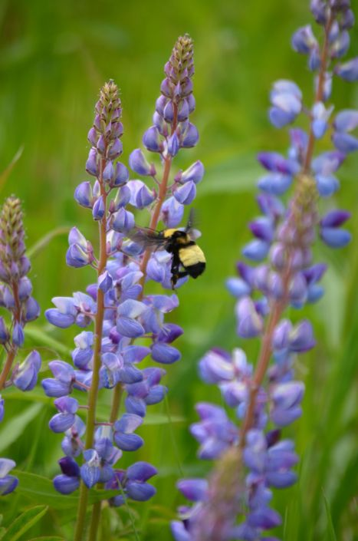

Slide 19
Plants for Wet Sites
Short:
● Blazing Star
● Black-eyed Susan
Shrubs:
●High bush cranberry
● Dogwoods
● Winterberry
● Nannyberry
Medium:
● Blue Iris
● Sweetgrass
Tall:
● Cardinal Flower
● Great Blue Lobelia
● Joe Pye Weed
● Blue Vervain
● Brown-eyed Susan
● Compass Plant
● Milkweed
● White Turtlehead
● Big Bluestem Grass

Slide 20
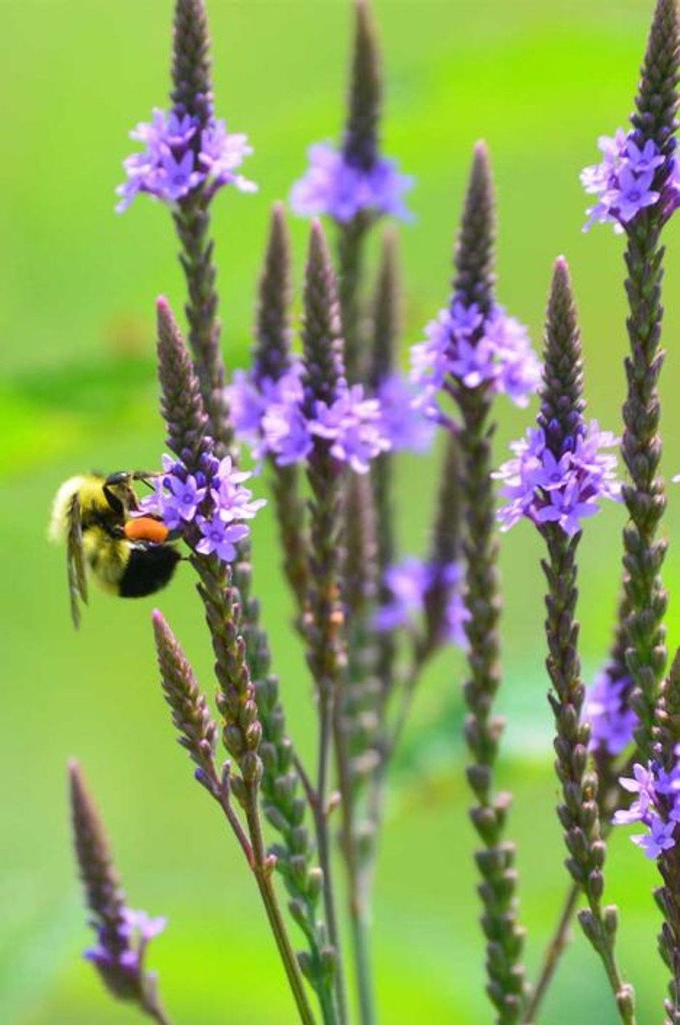
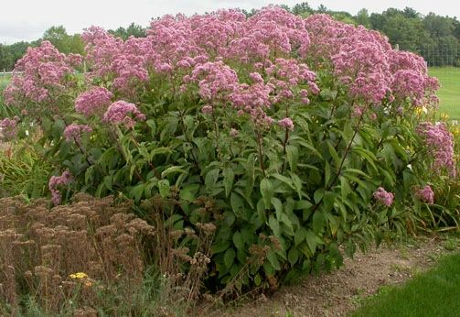

Slide 21
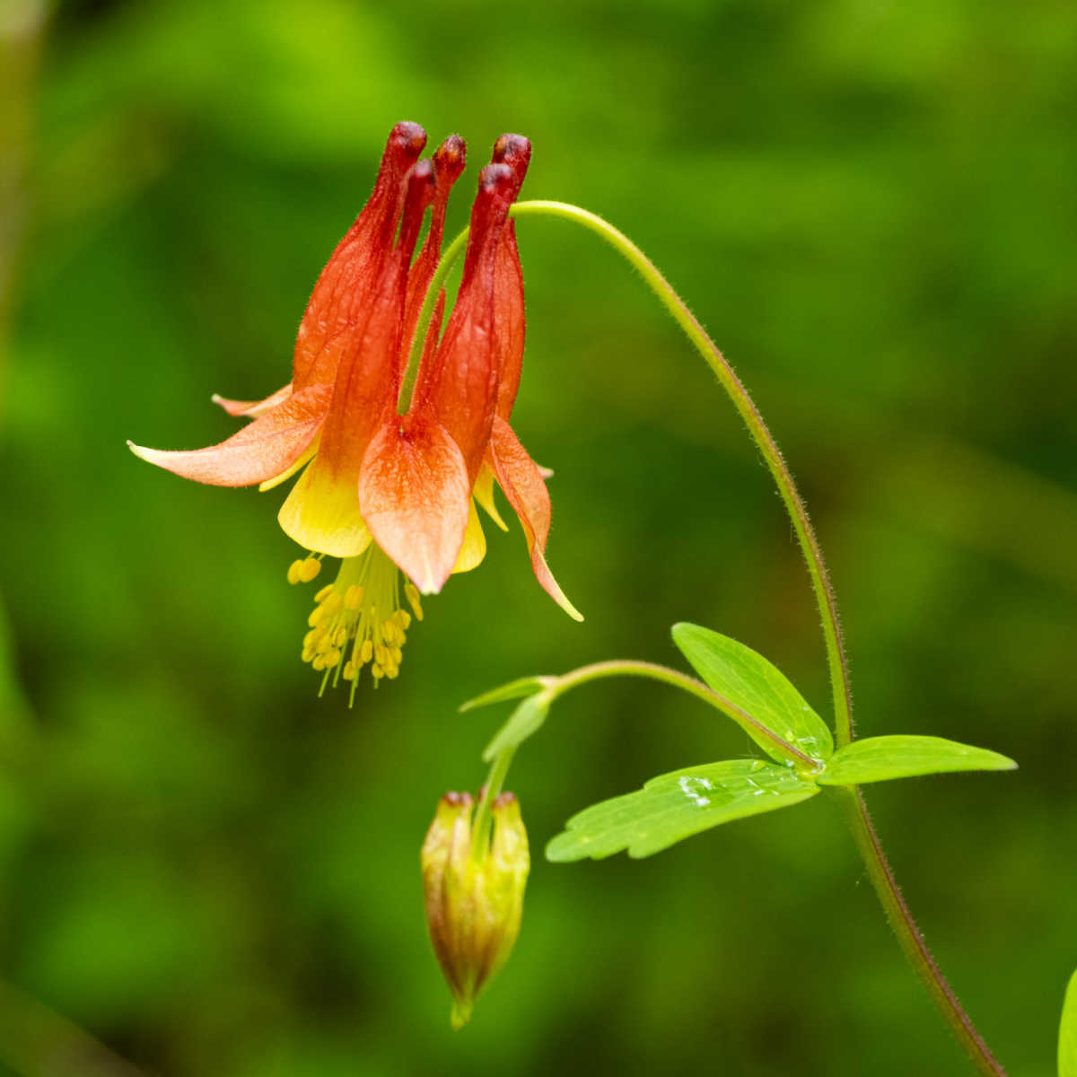
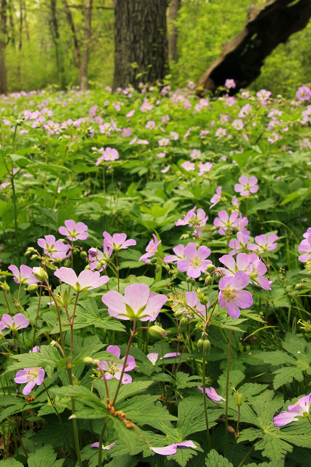
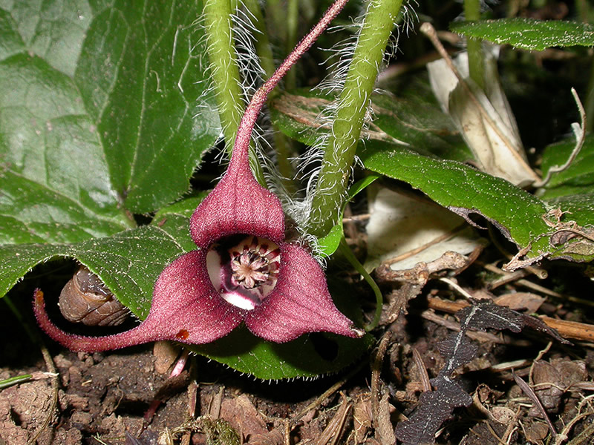
Plants for Shady Areas
Short:
● Columbine
● Wild ginger
● Wild geranium
● Jacob’s Ladder
● Thimbleweed
Medium:
● Bottlebrush Grass
Tall:
● Woodland Sunflower
Shrubs:
● Serviceberry, Hazelnut, Viburnums

Slide 22
Plants for Medium Sites
Short:
● Thimbleweed
● Butterfly Weed
● Wild Geranium
● Wild Ginger
● Columbine
● Black-eyed Susan
● Blazing Star
● Jacob’s Ladder
● Prairie Smoke
● Prairie Coreopsis
● Prairie Dropseed Grass
Medium:
● Pale Purple Coneflower
● Wild Lupine
● Foxglove Beardtongue
● Little Bluestem Grass
● Bottlebrush Grass
● Sweetgrass
Shrubs:
●Viburnum, Hazelnut, Ninebark,
Elderberry, Serviceberry
Tall:
● Milkweed
● Purple Coneflower
● Gray-headed Coneflower
● Wild Bergamot
● Brown-eyed Susan
● Woodland Sunflower
● Blue Vervain
● Compass Plant
● Big Bluestem Grass

Slide 23
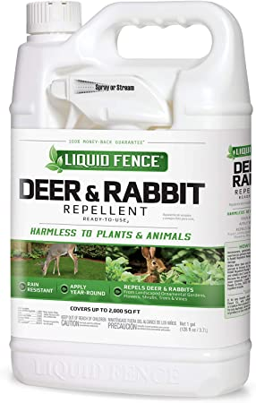
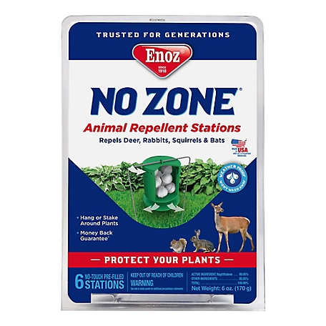
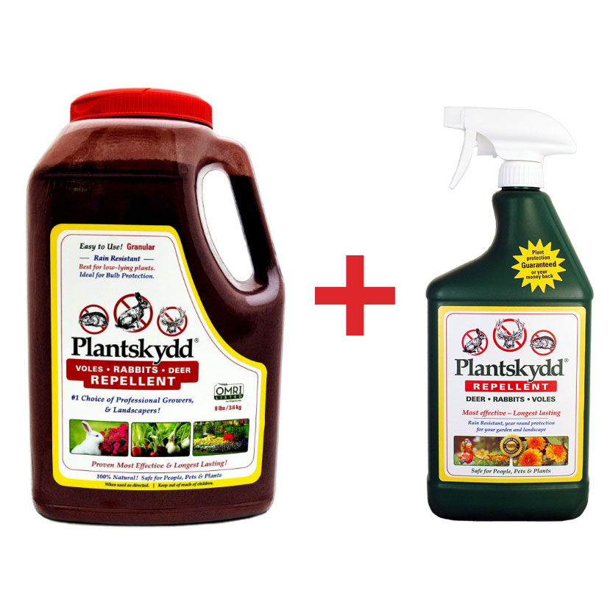
Animals, Pests, Mulch, Weeds
Deer and Rabbits

Slide 24
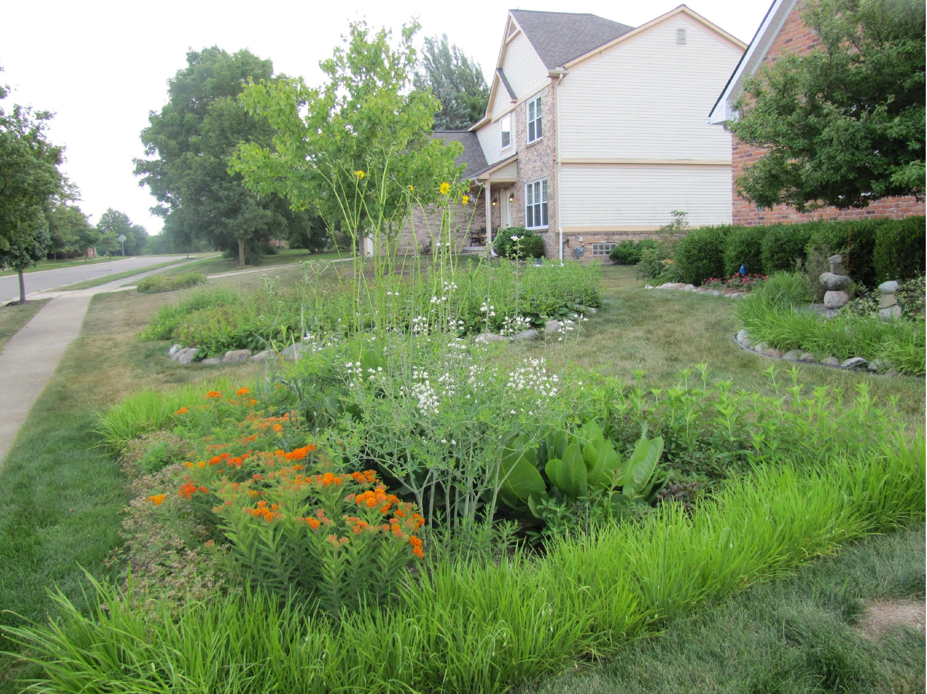
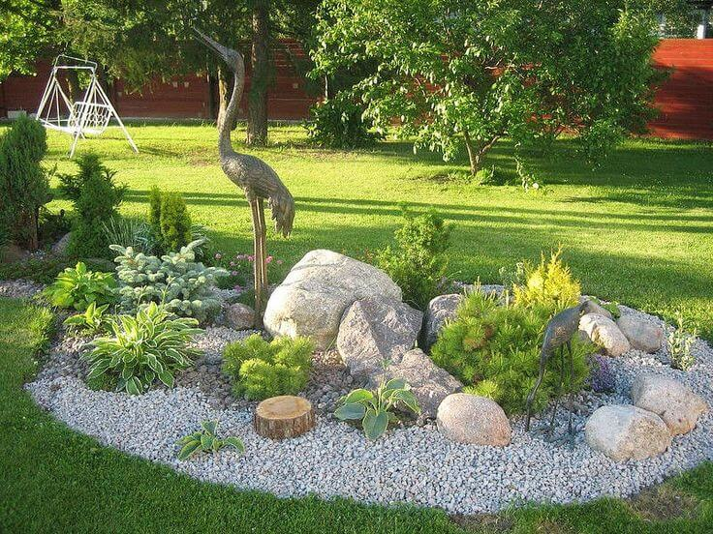
Animals, Pests, Mulch, Weeds

Slide 25
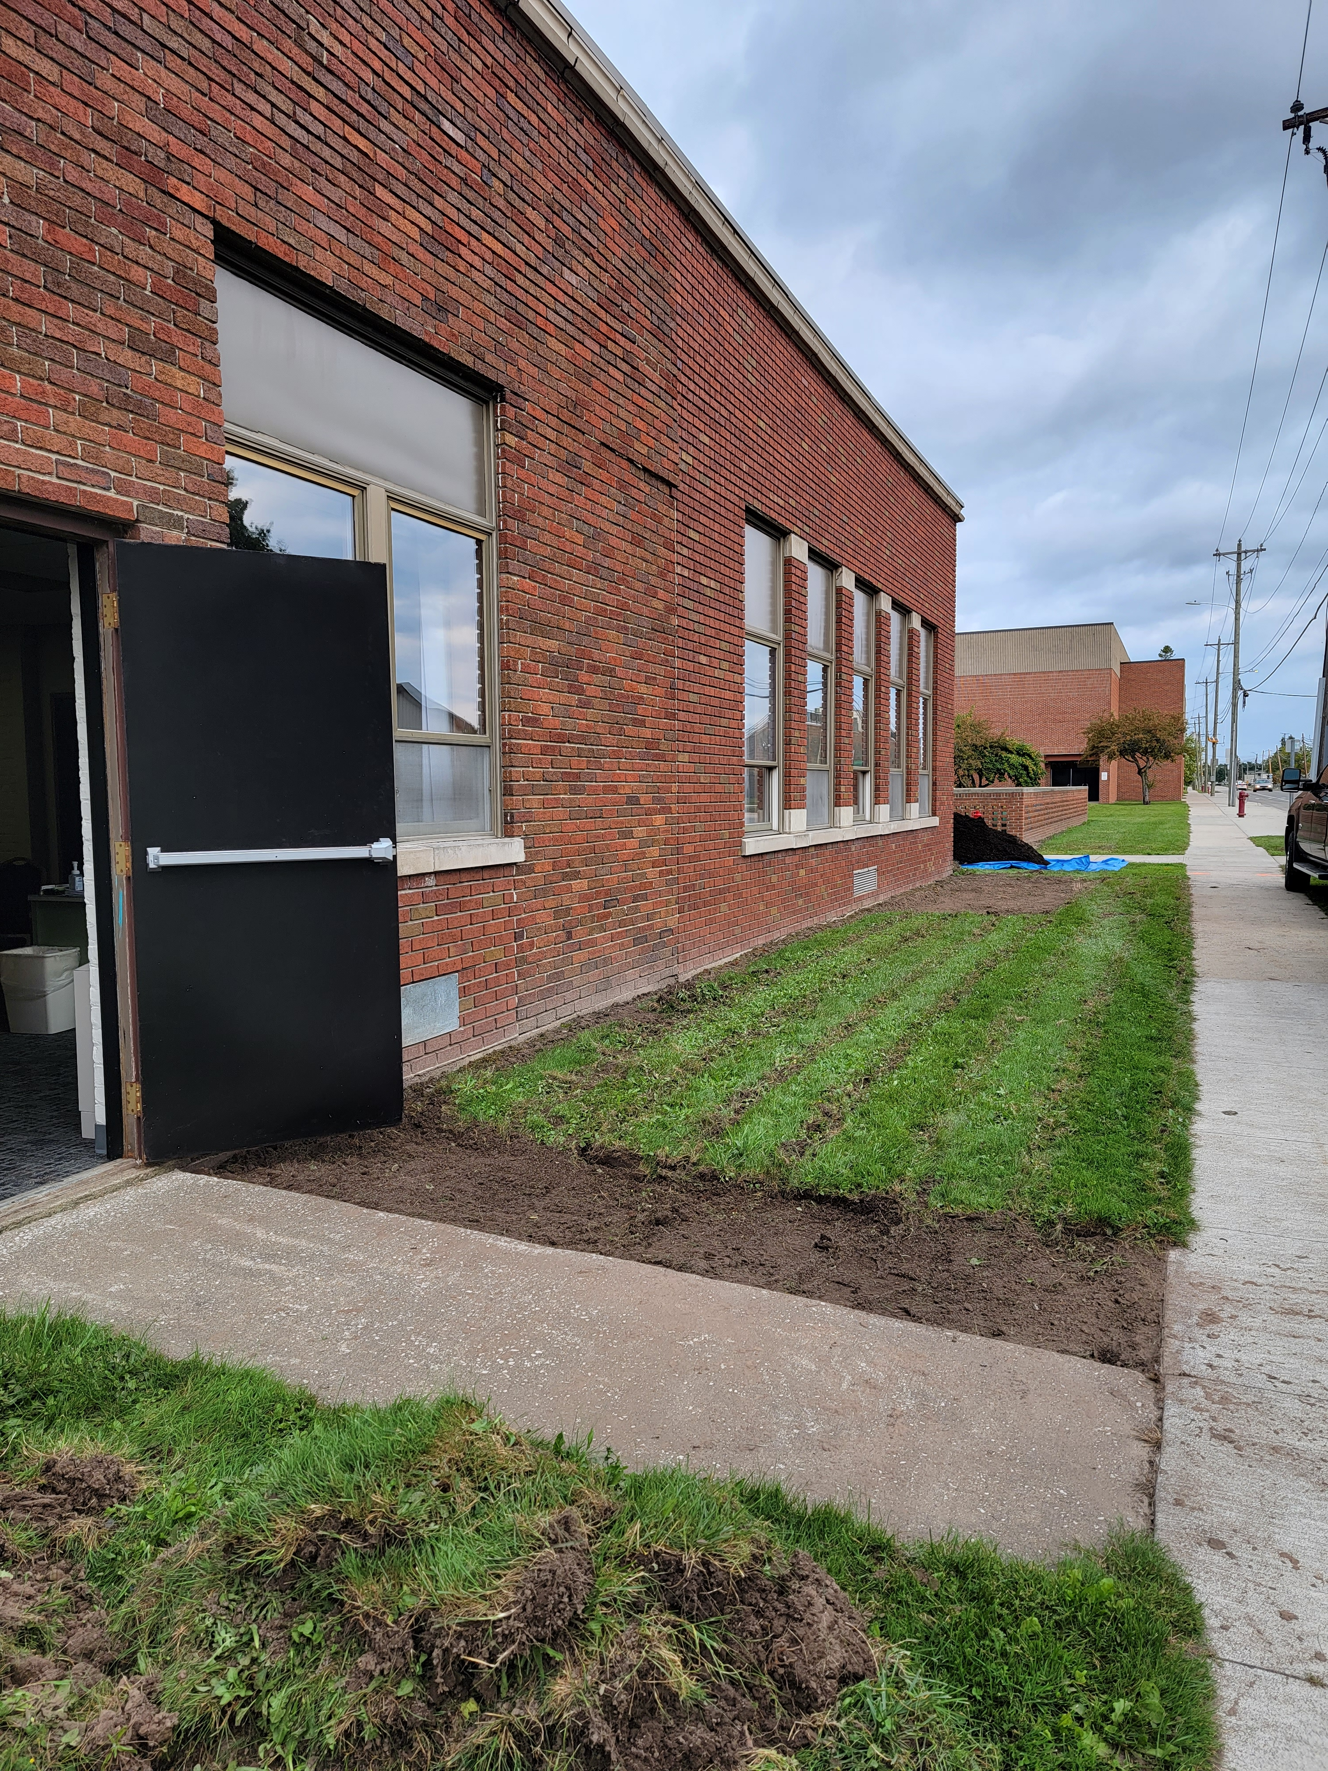
Manistique High School Pollinator Garden

Slide 26
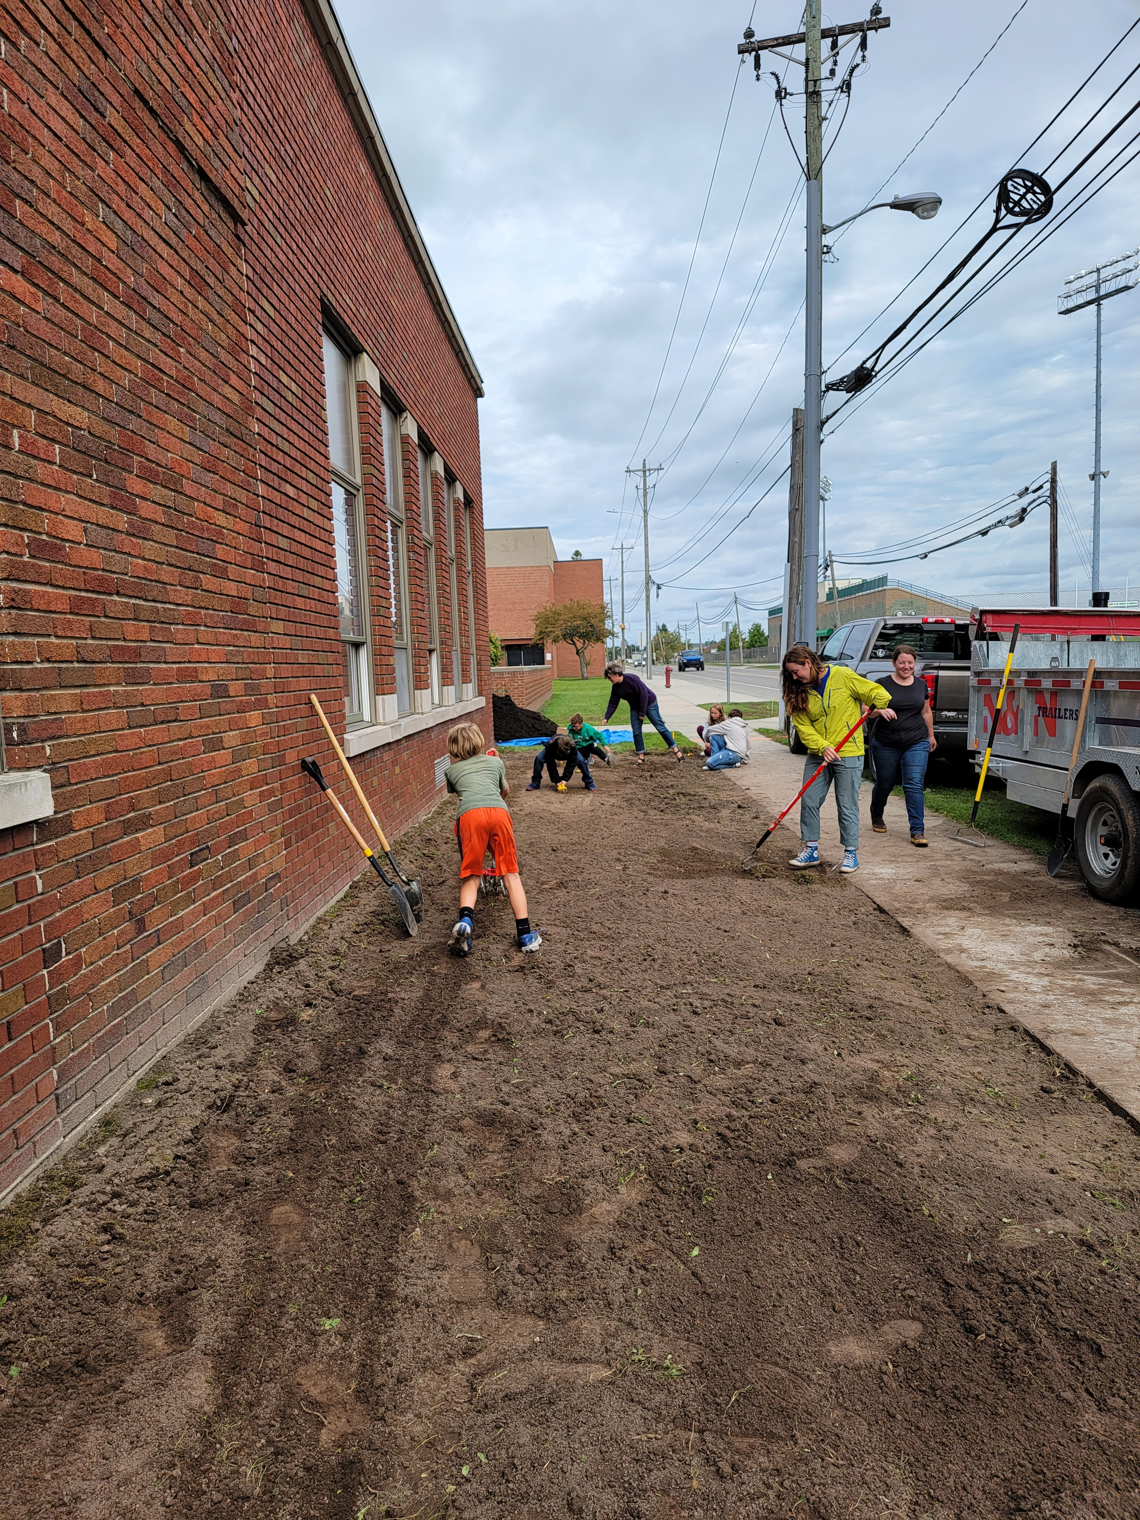

Slide 27
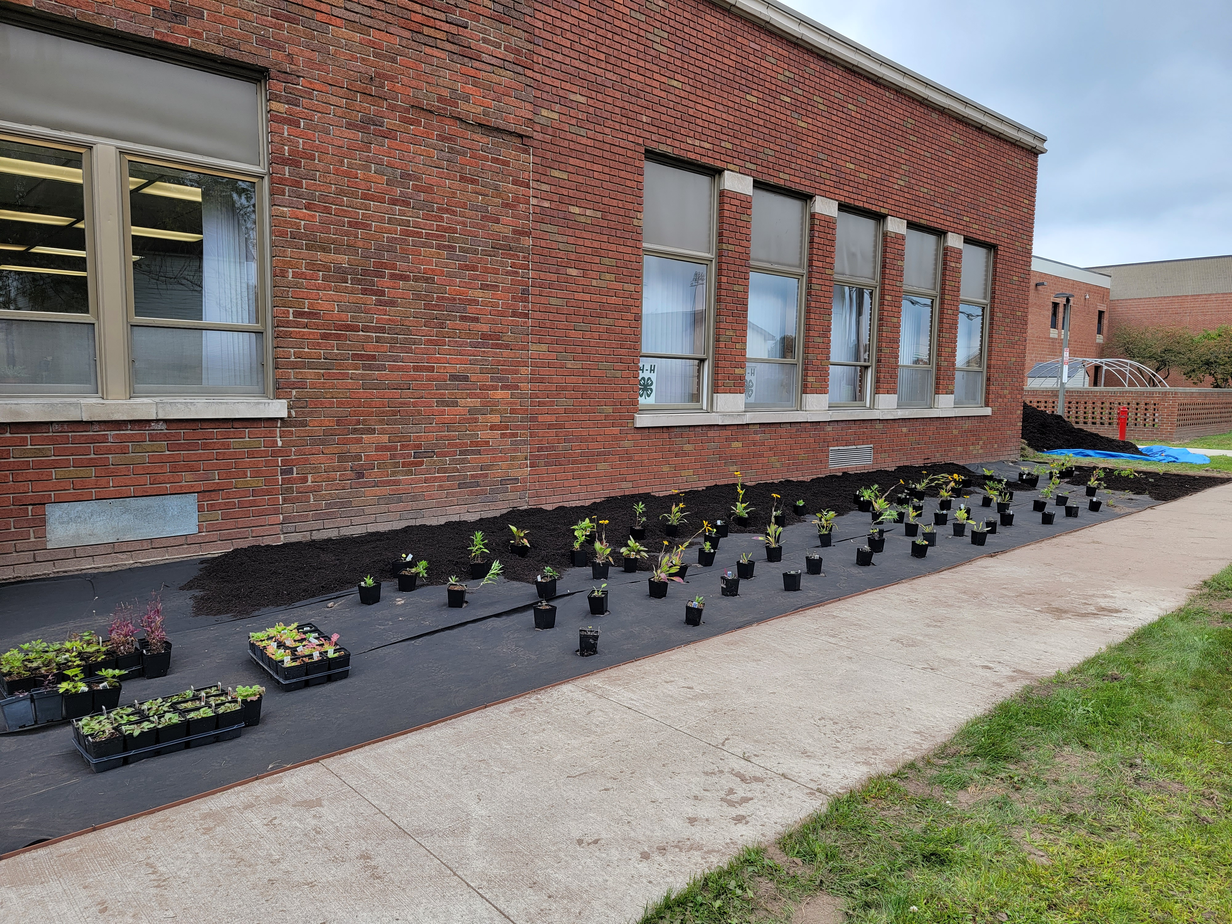

Slide 28
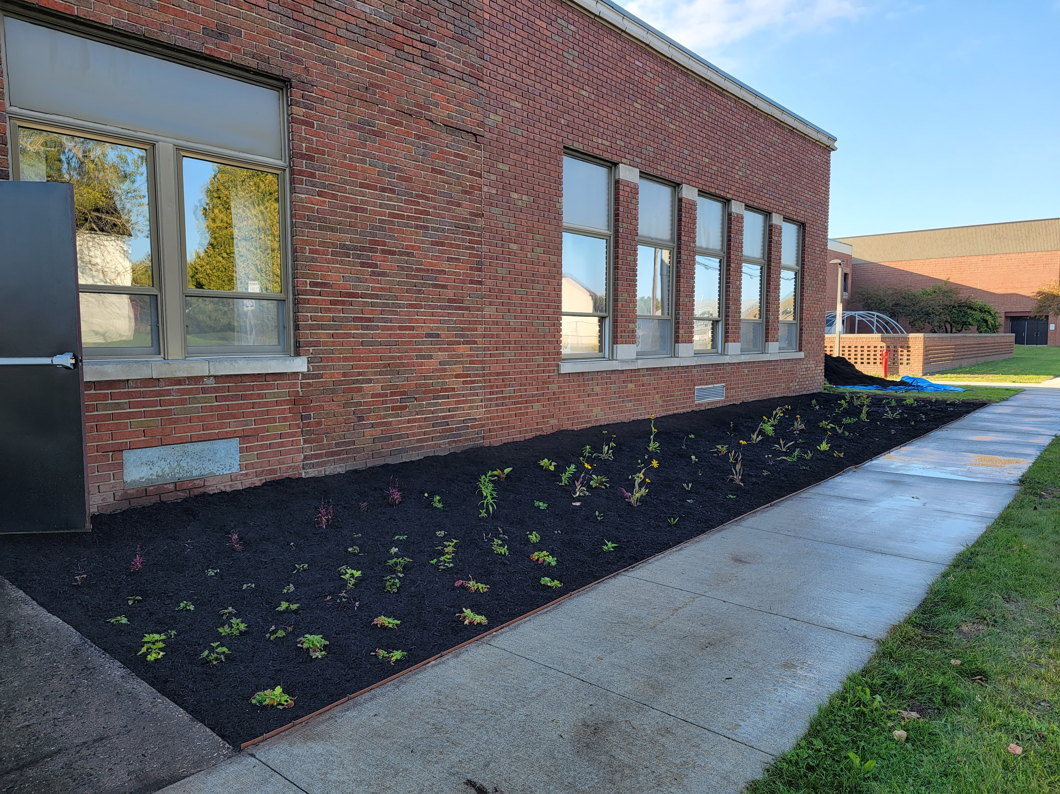

Slide 29
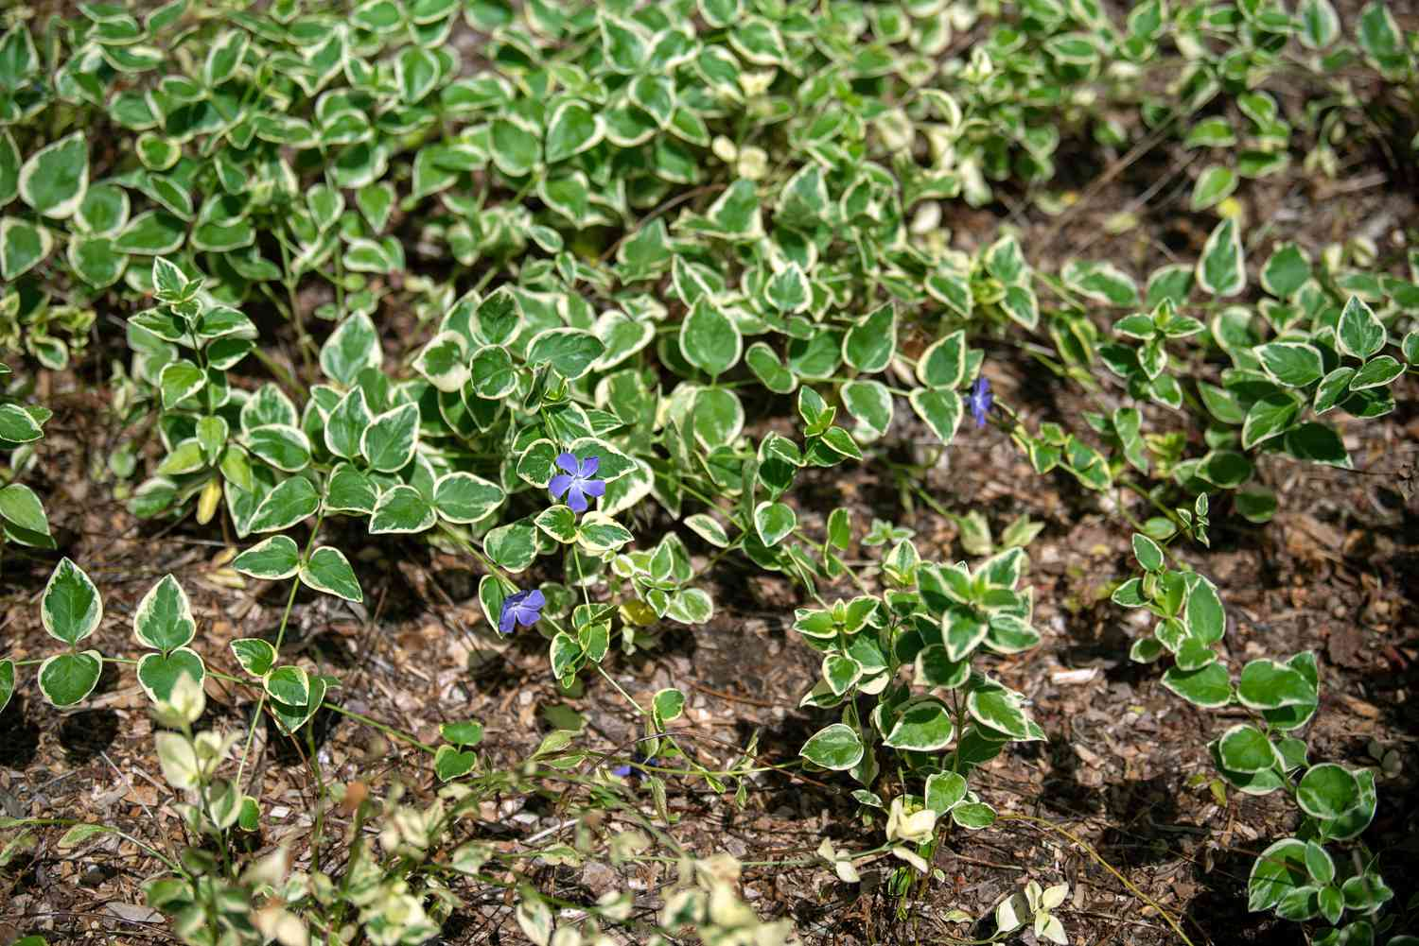
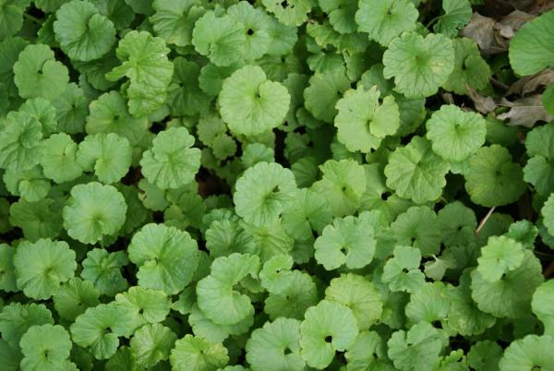
Invasive Species

Slide 30
A Dose of Realism
There are other reasons we choose plants for our gardens
Historical
Sentimental
Just because!
Even if a plant isn’t a native plant, it does not mean it is “bad”

Slide 31
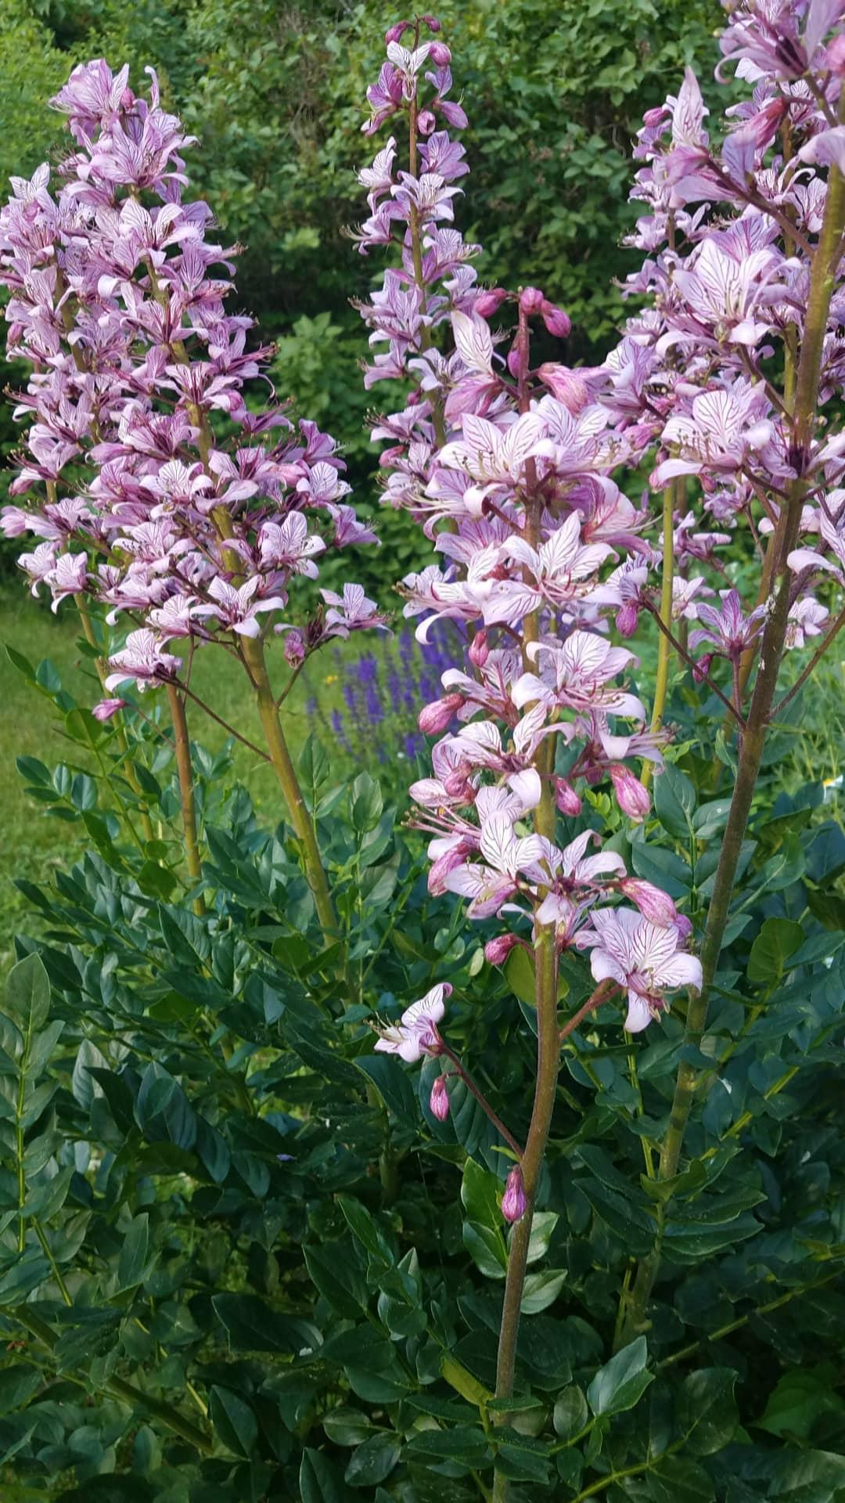
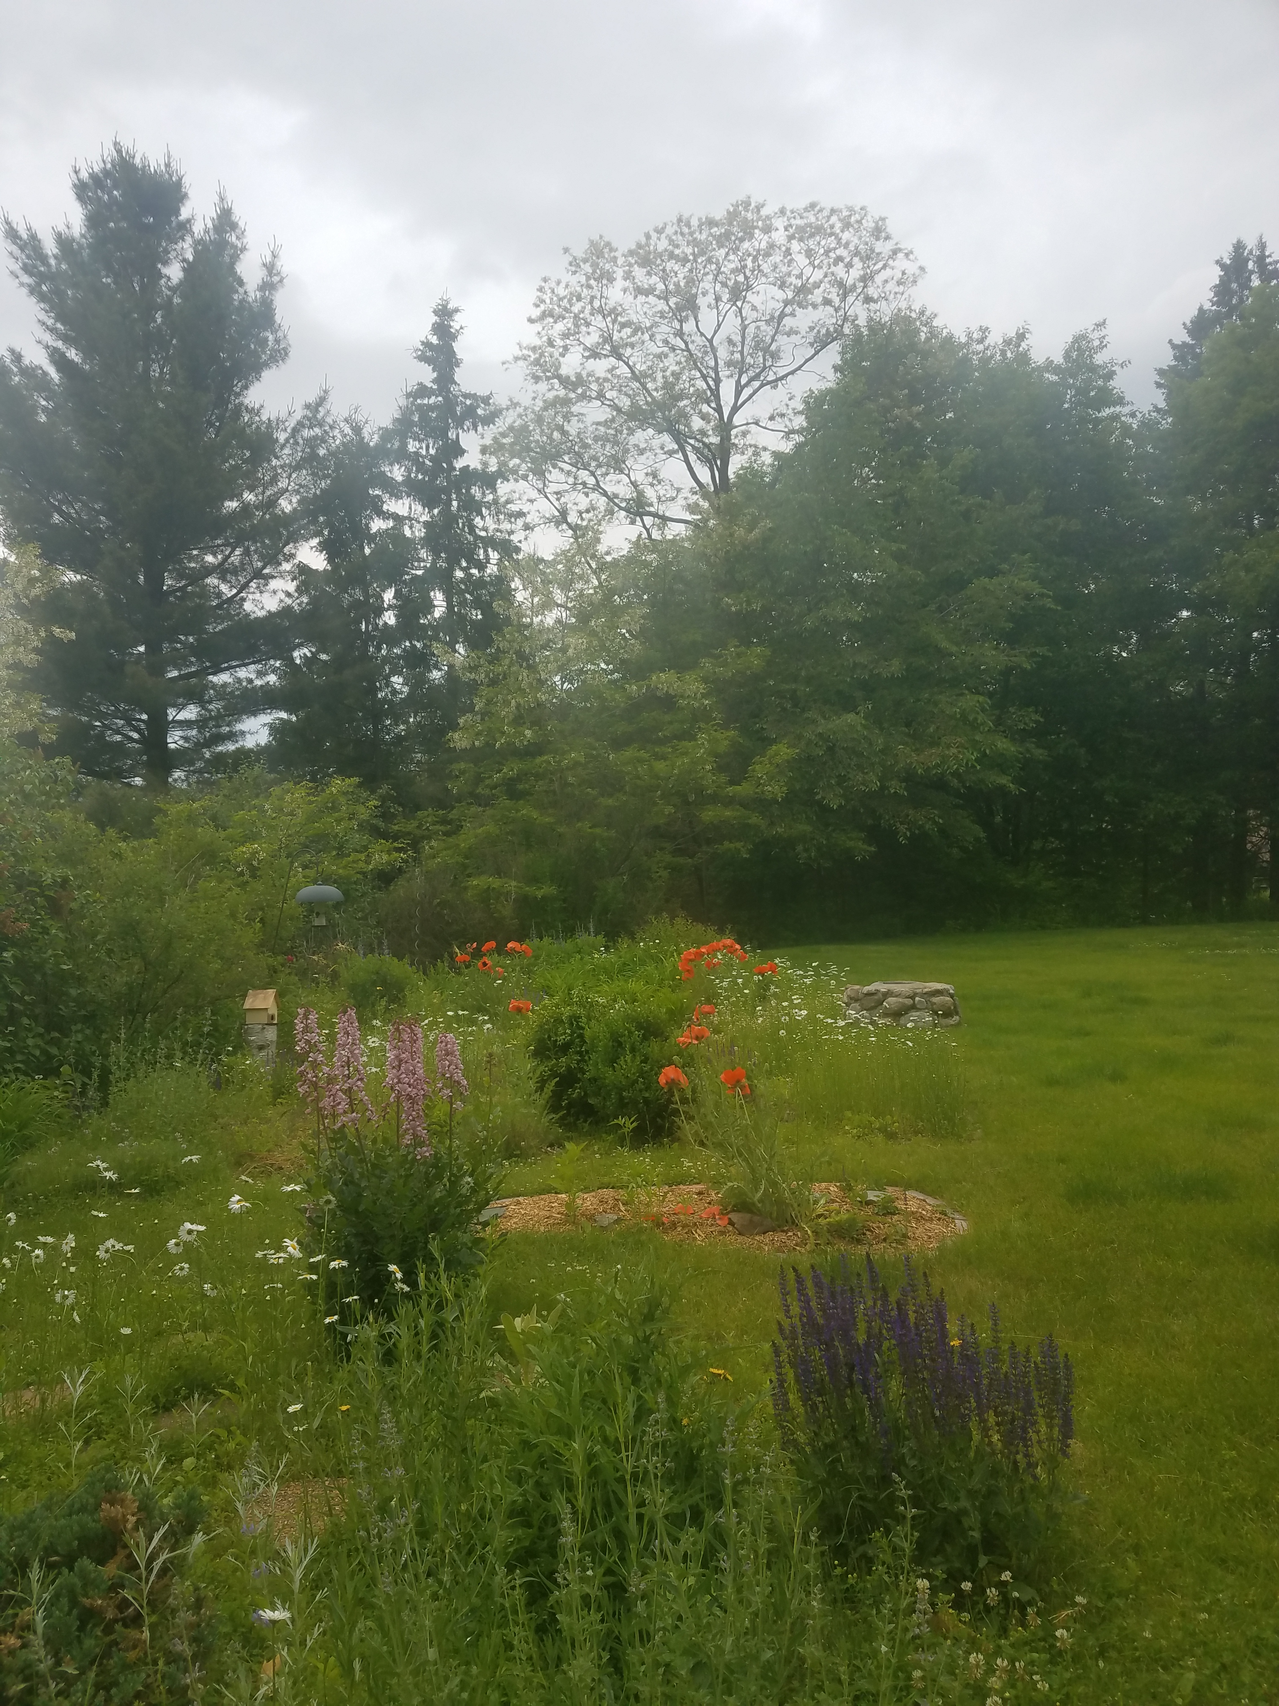

Slide 32
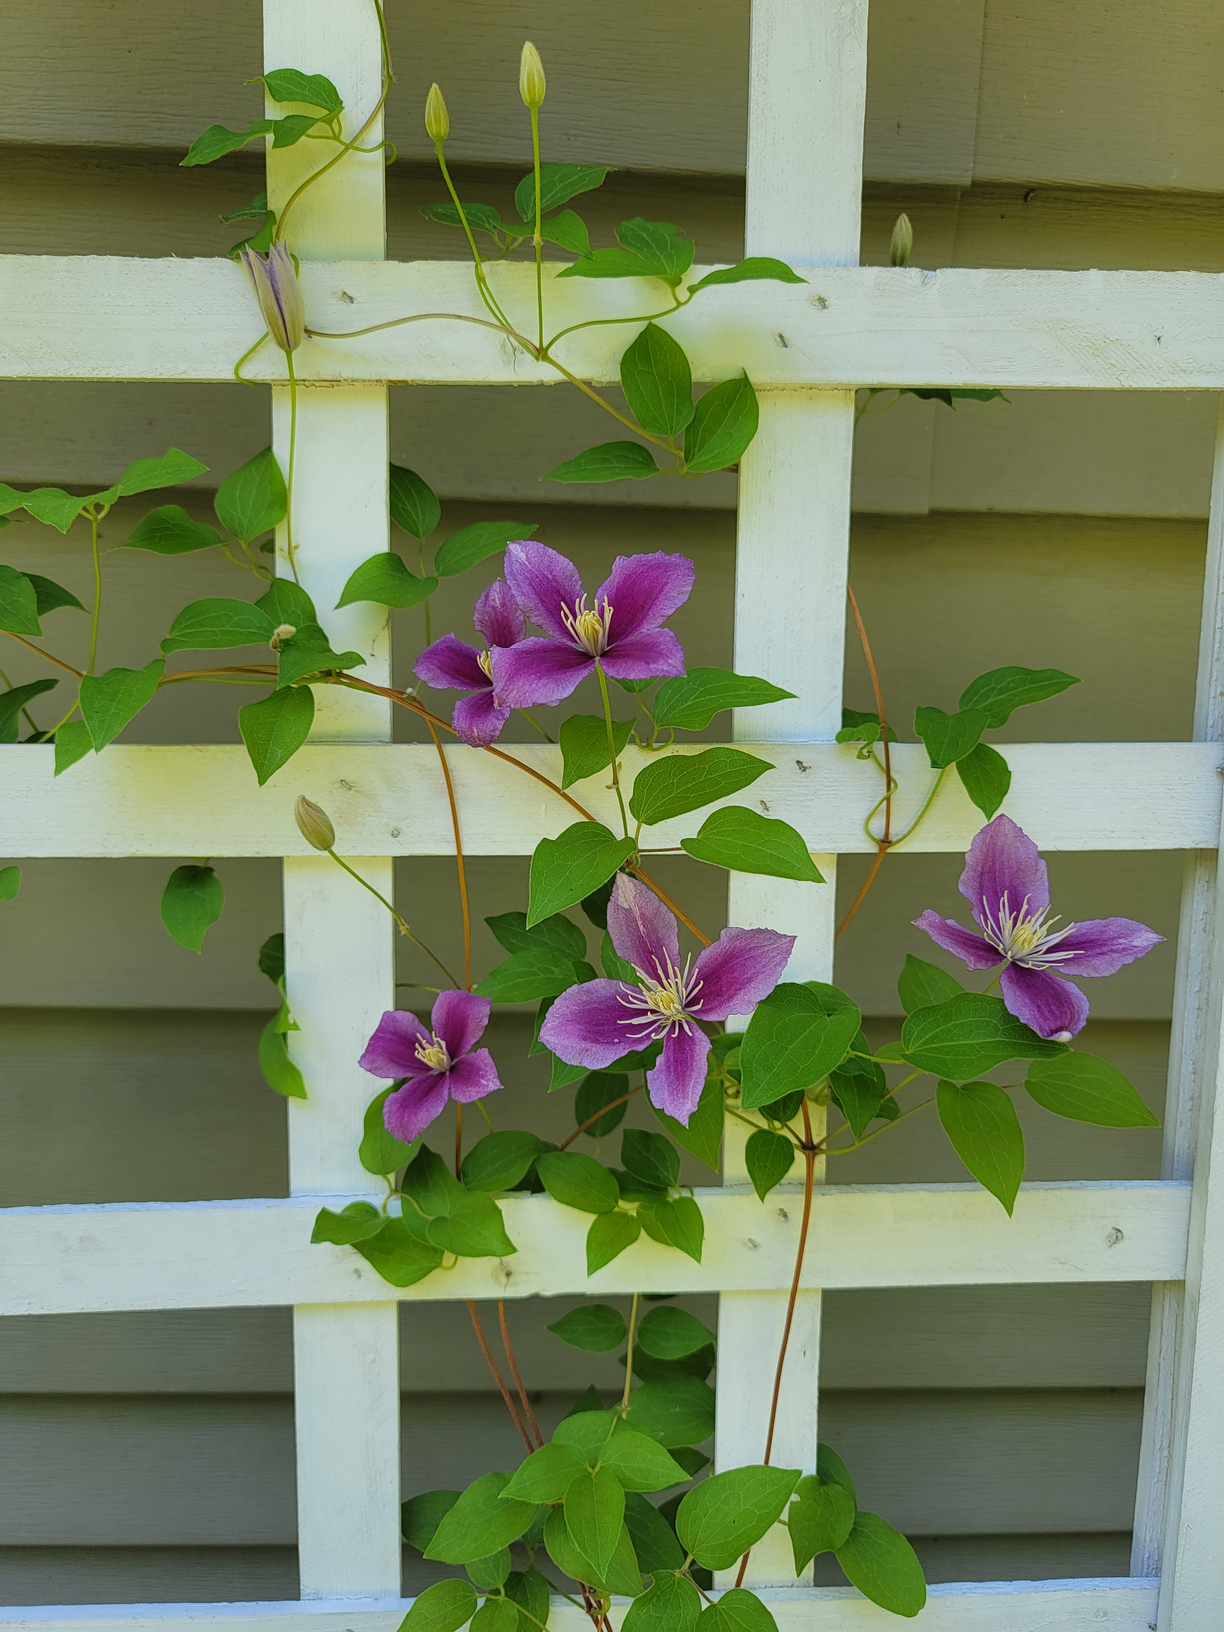
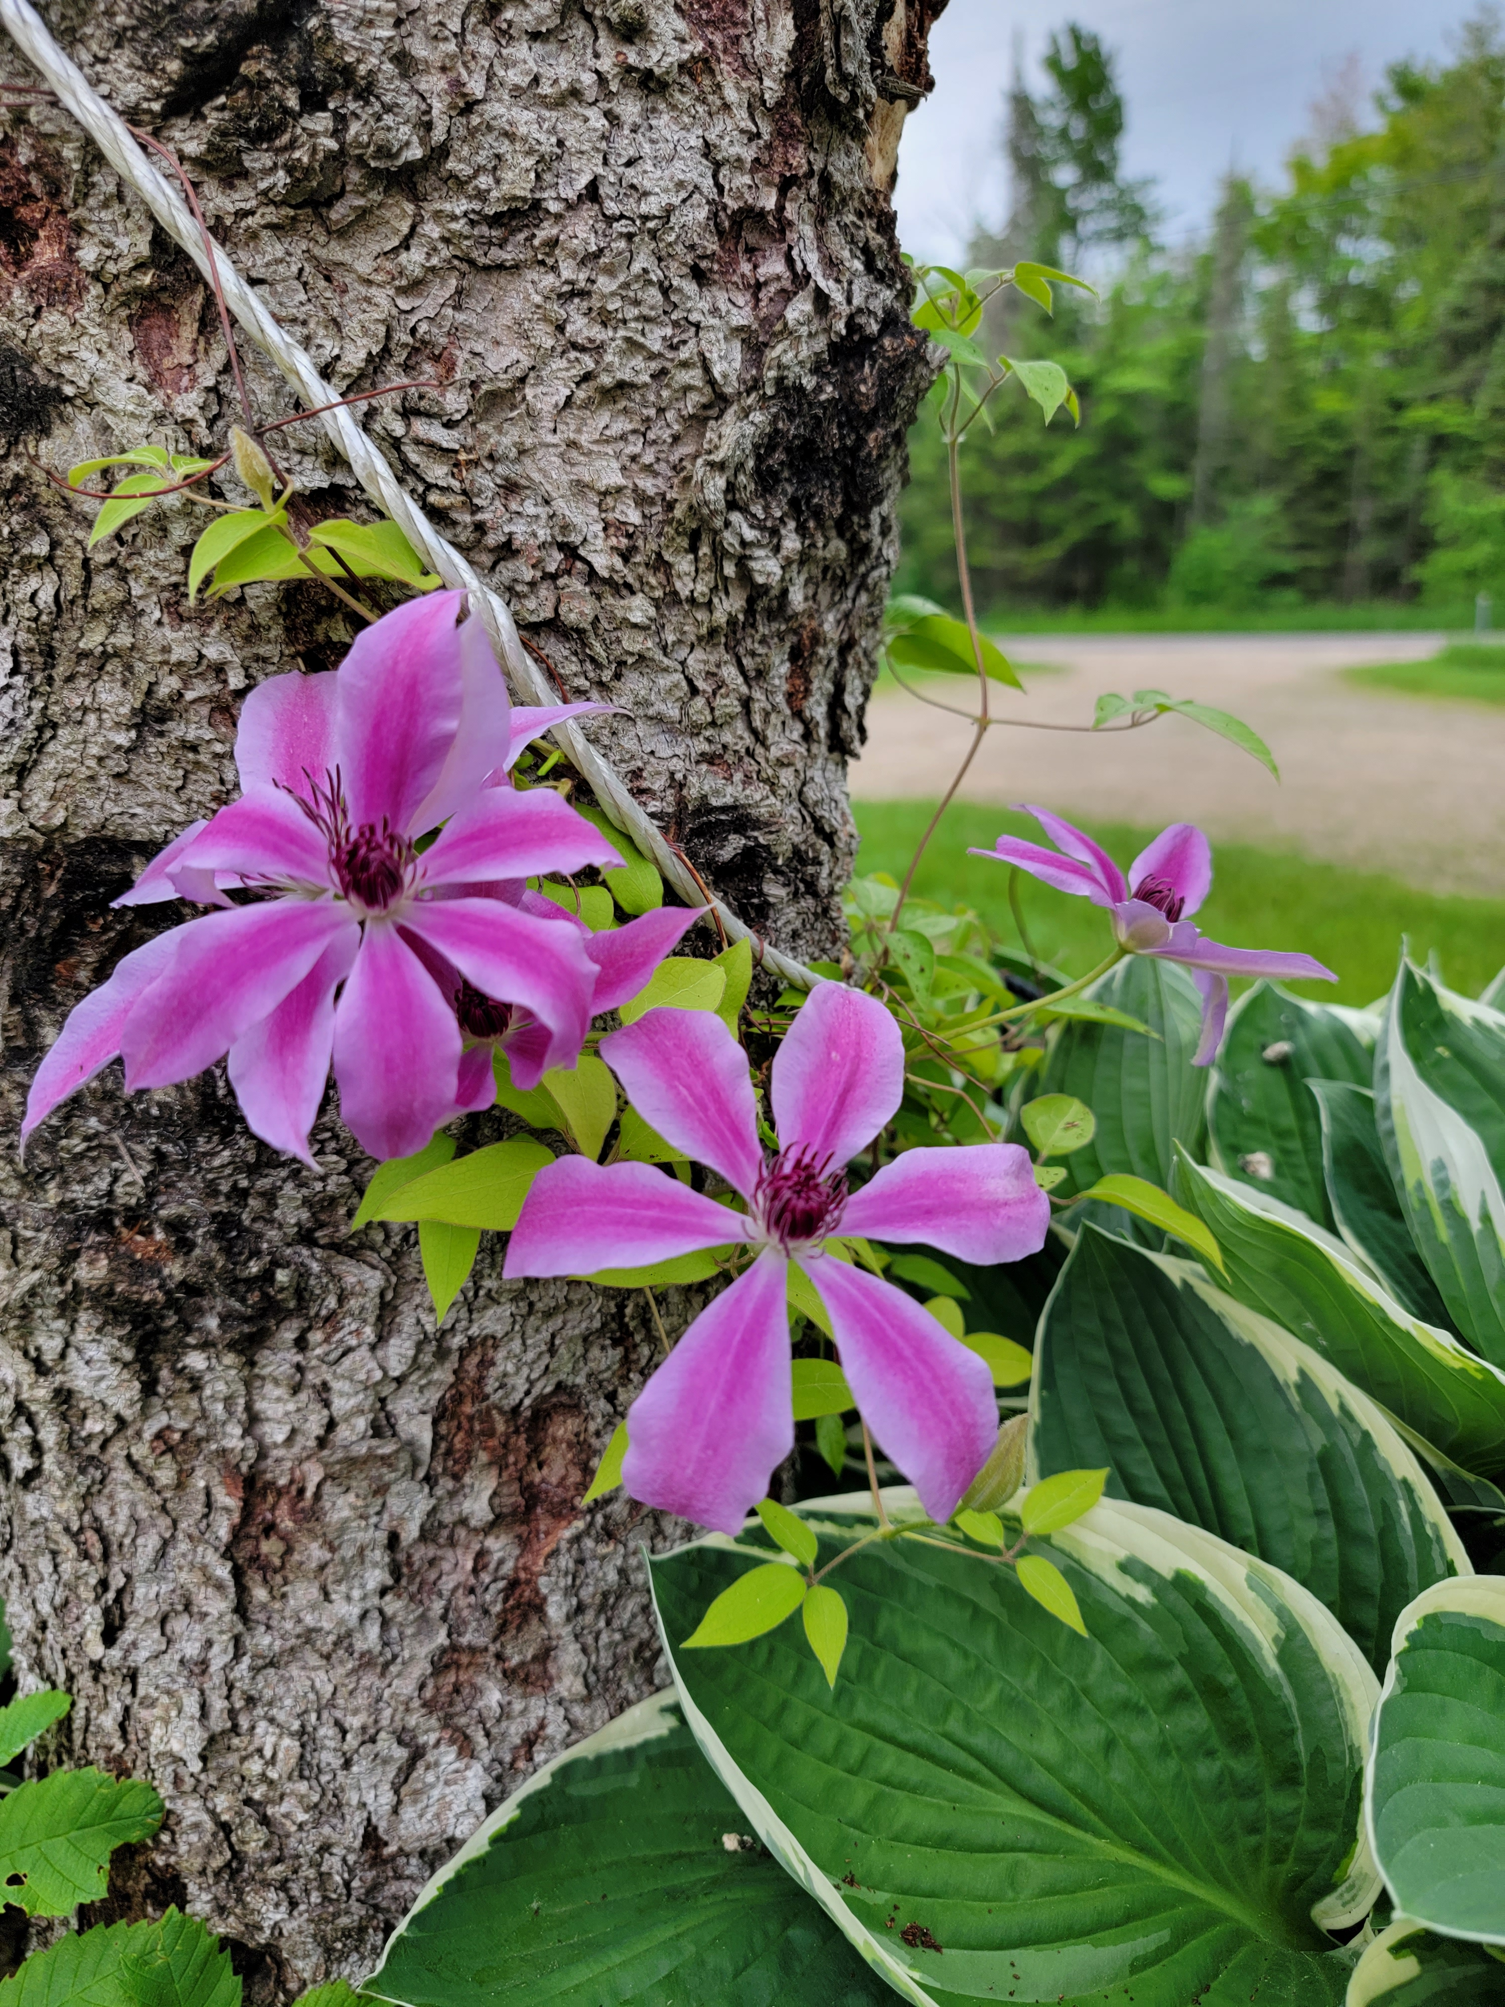

Slide 33
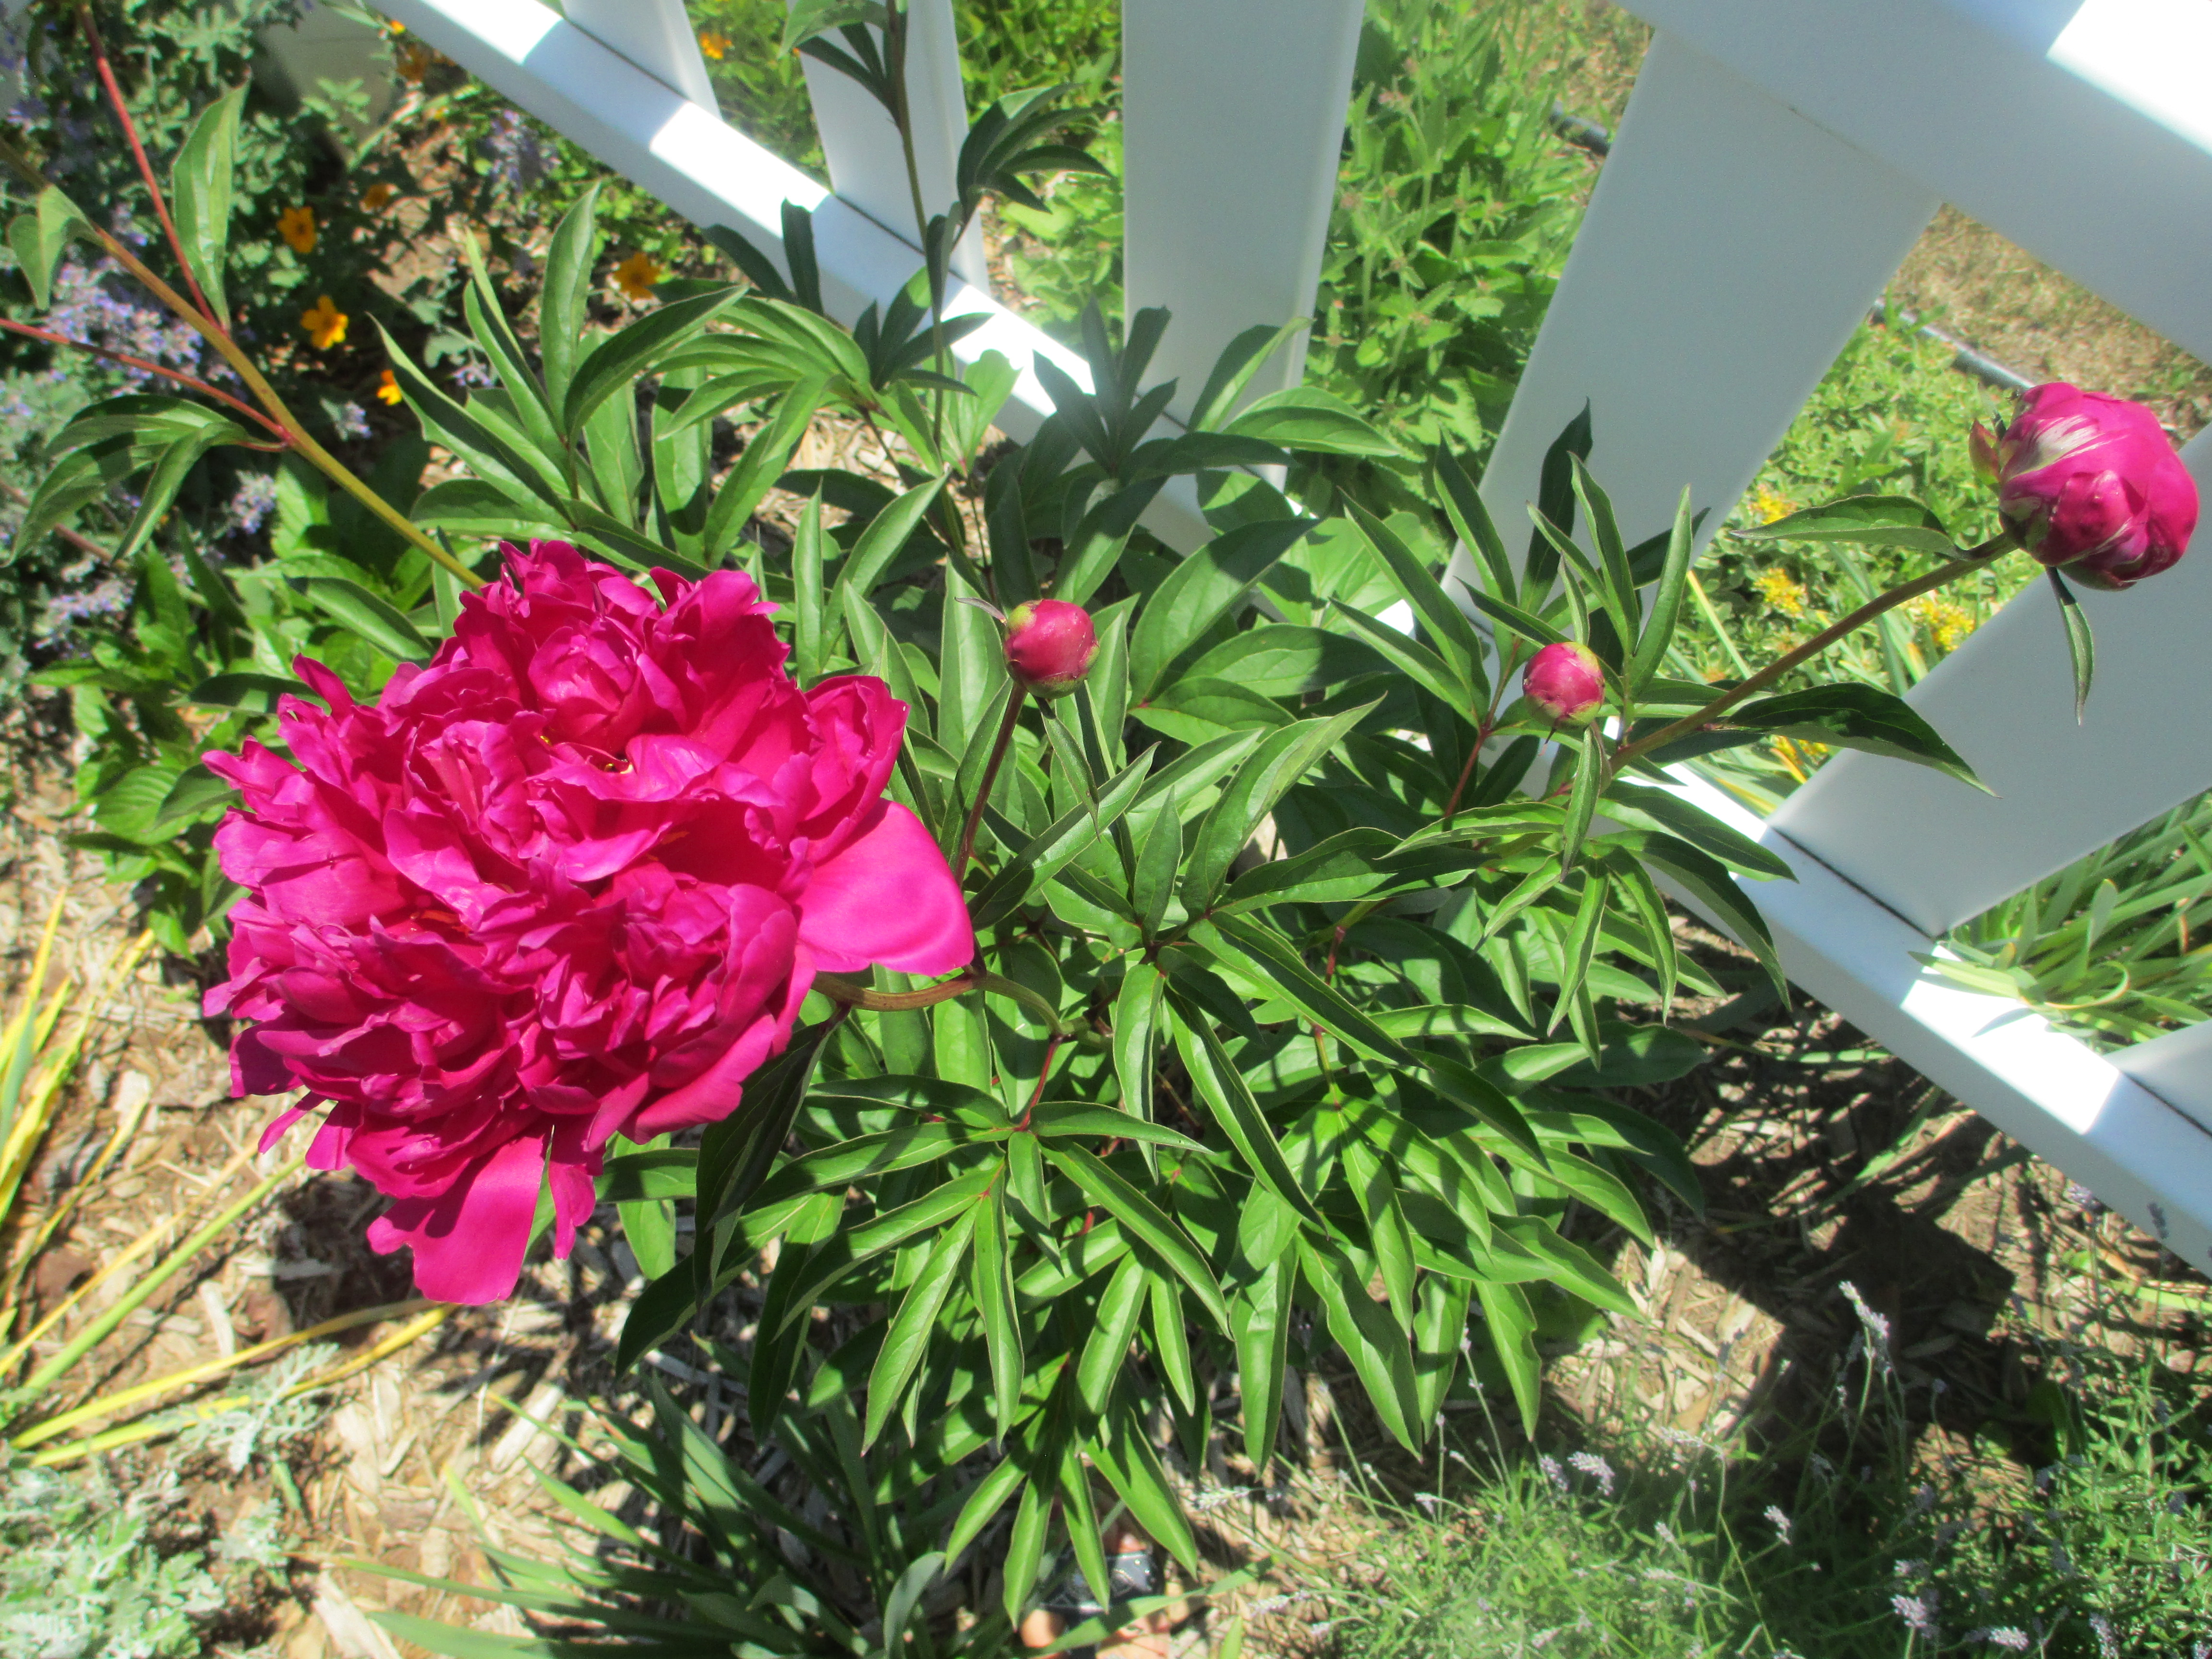
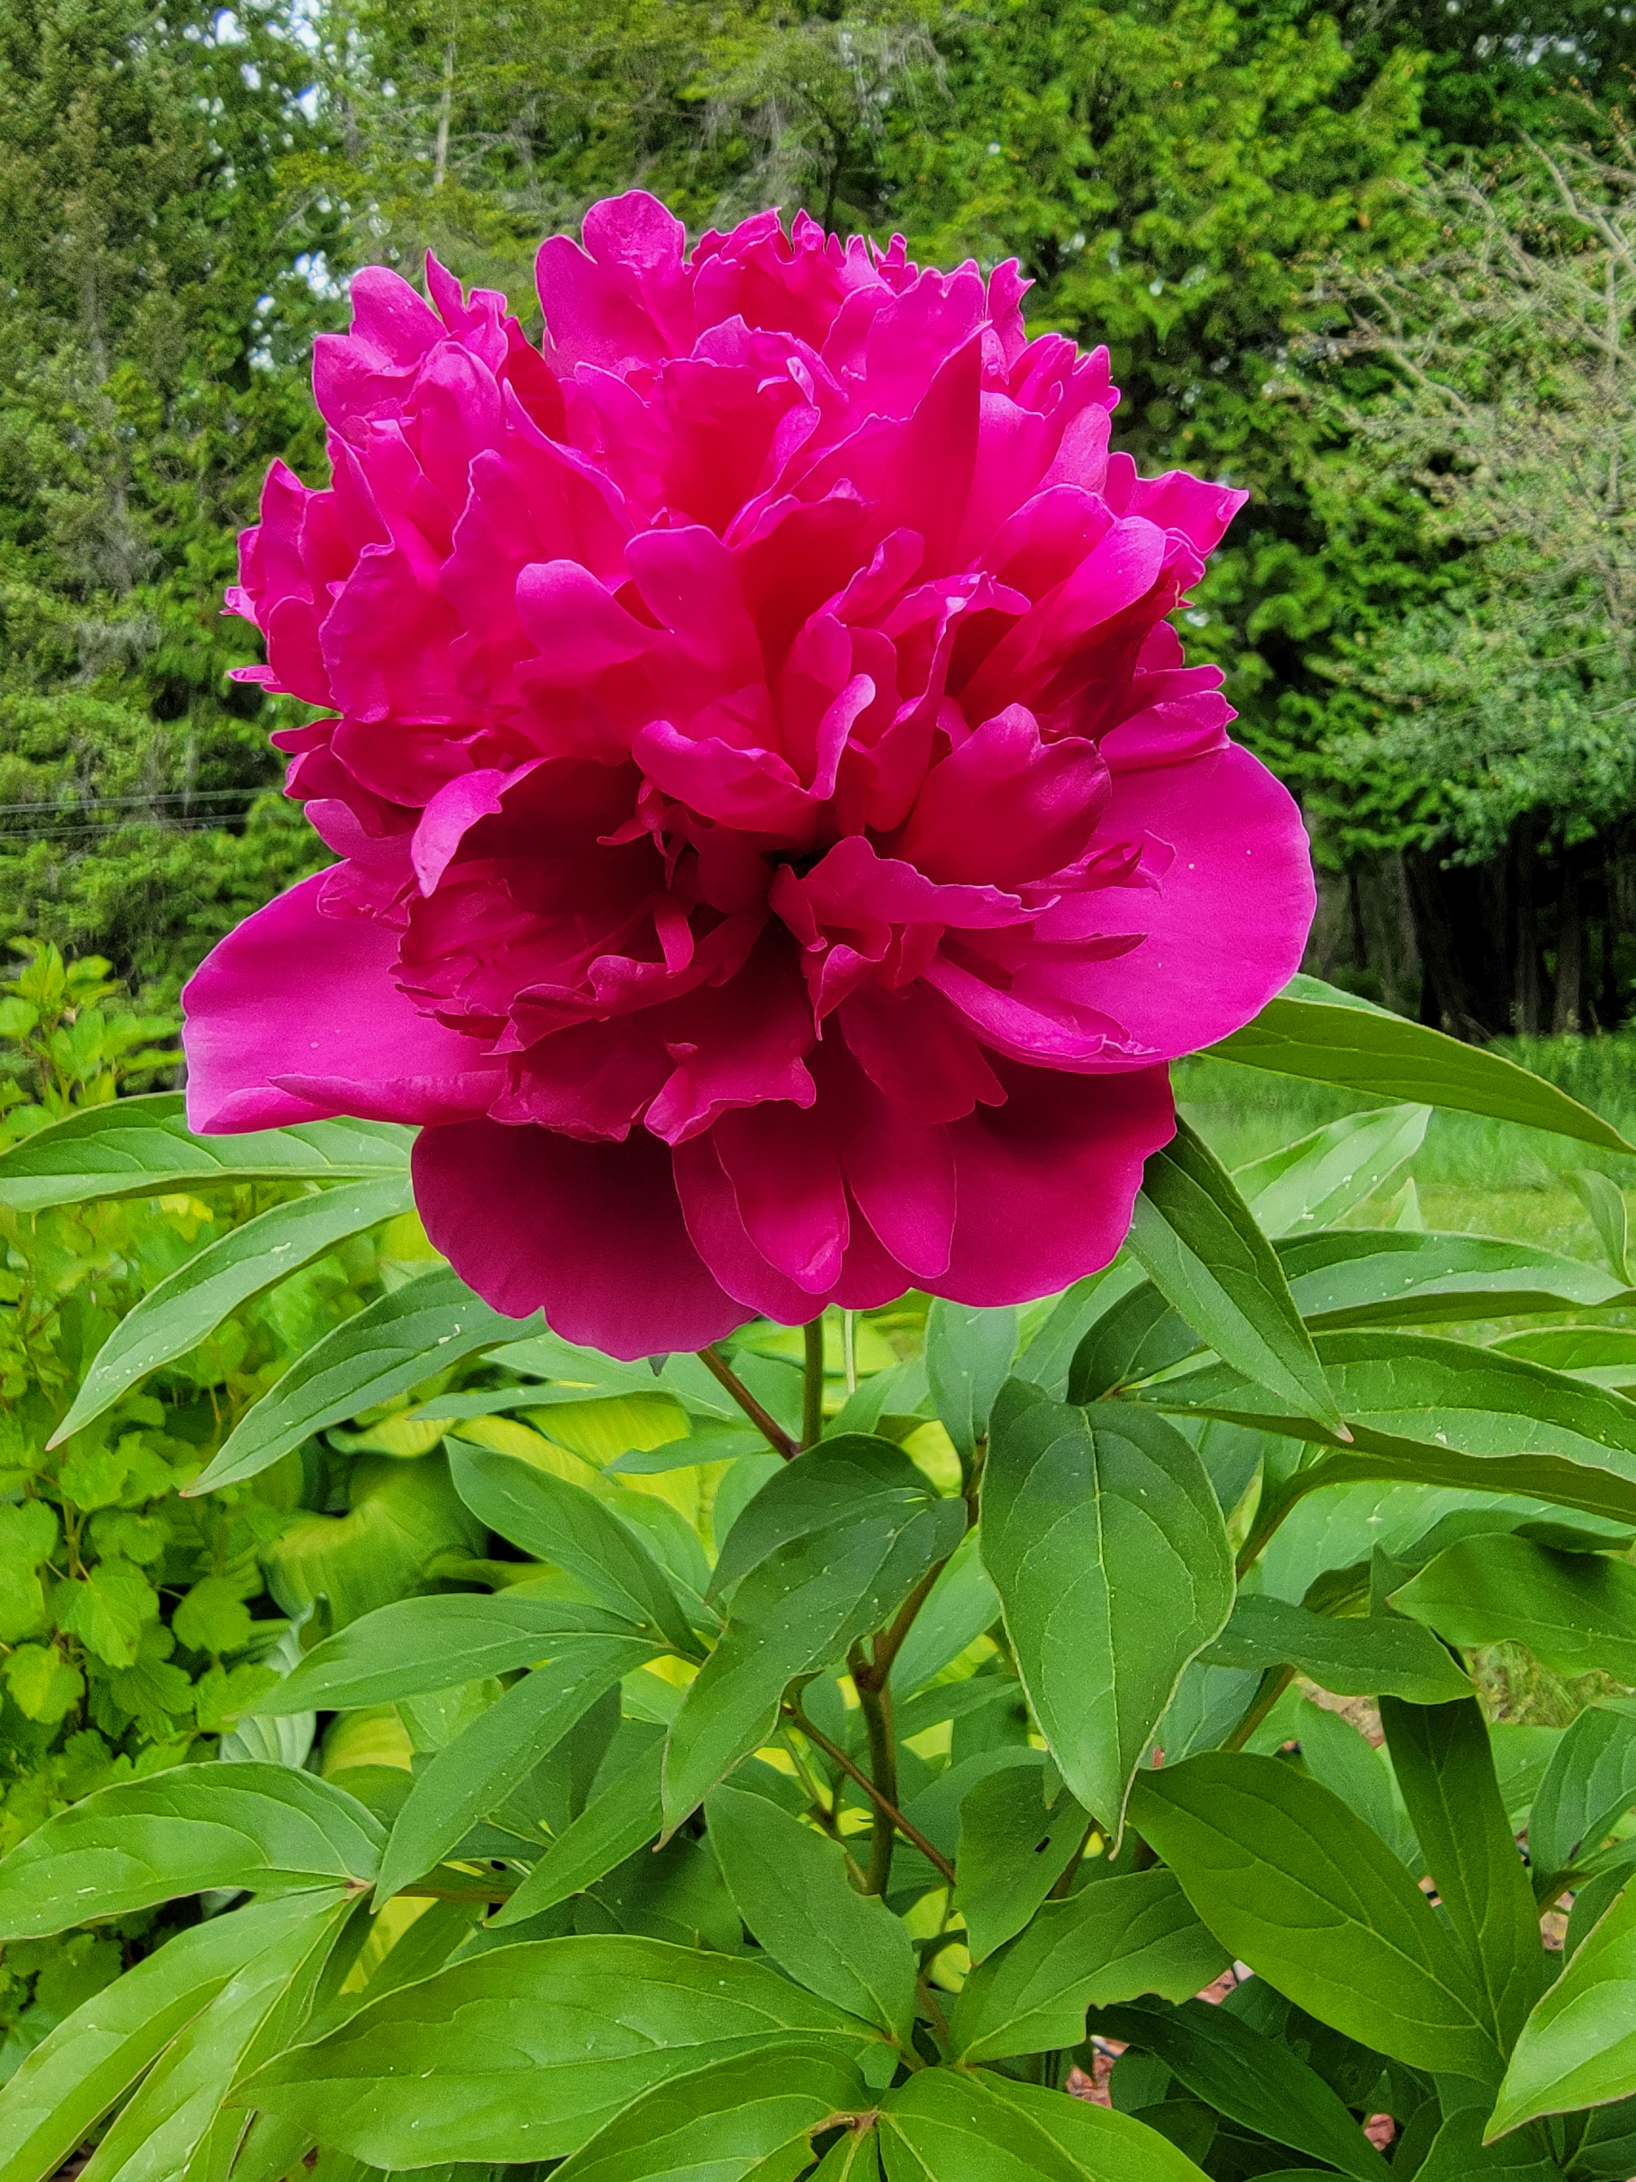

Slide 34
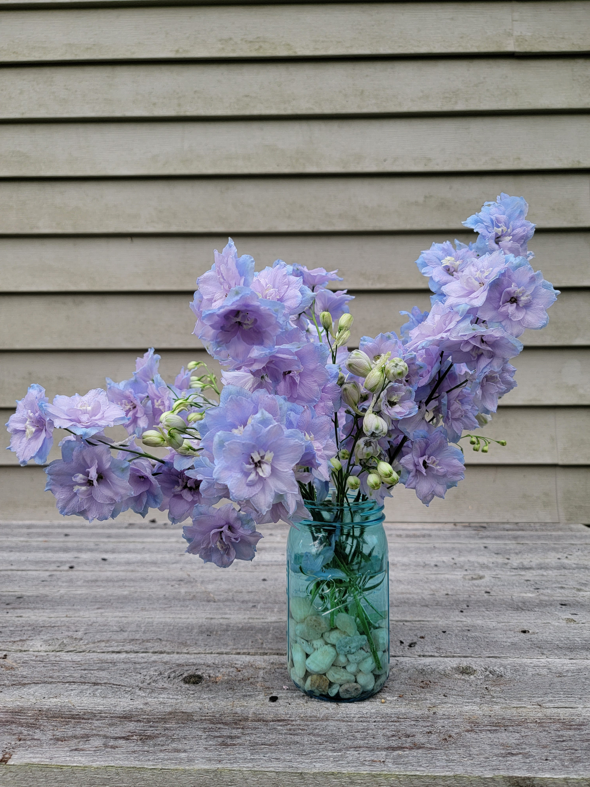
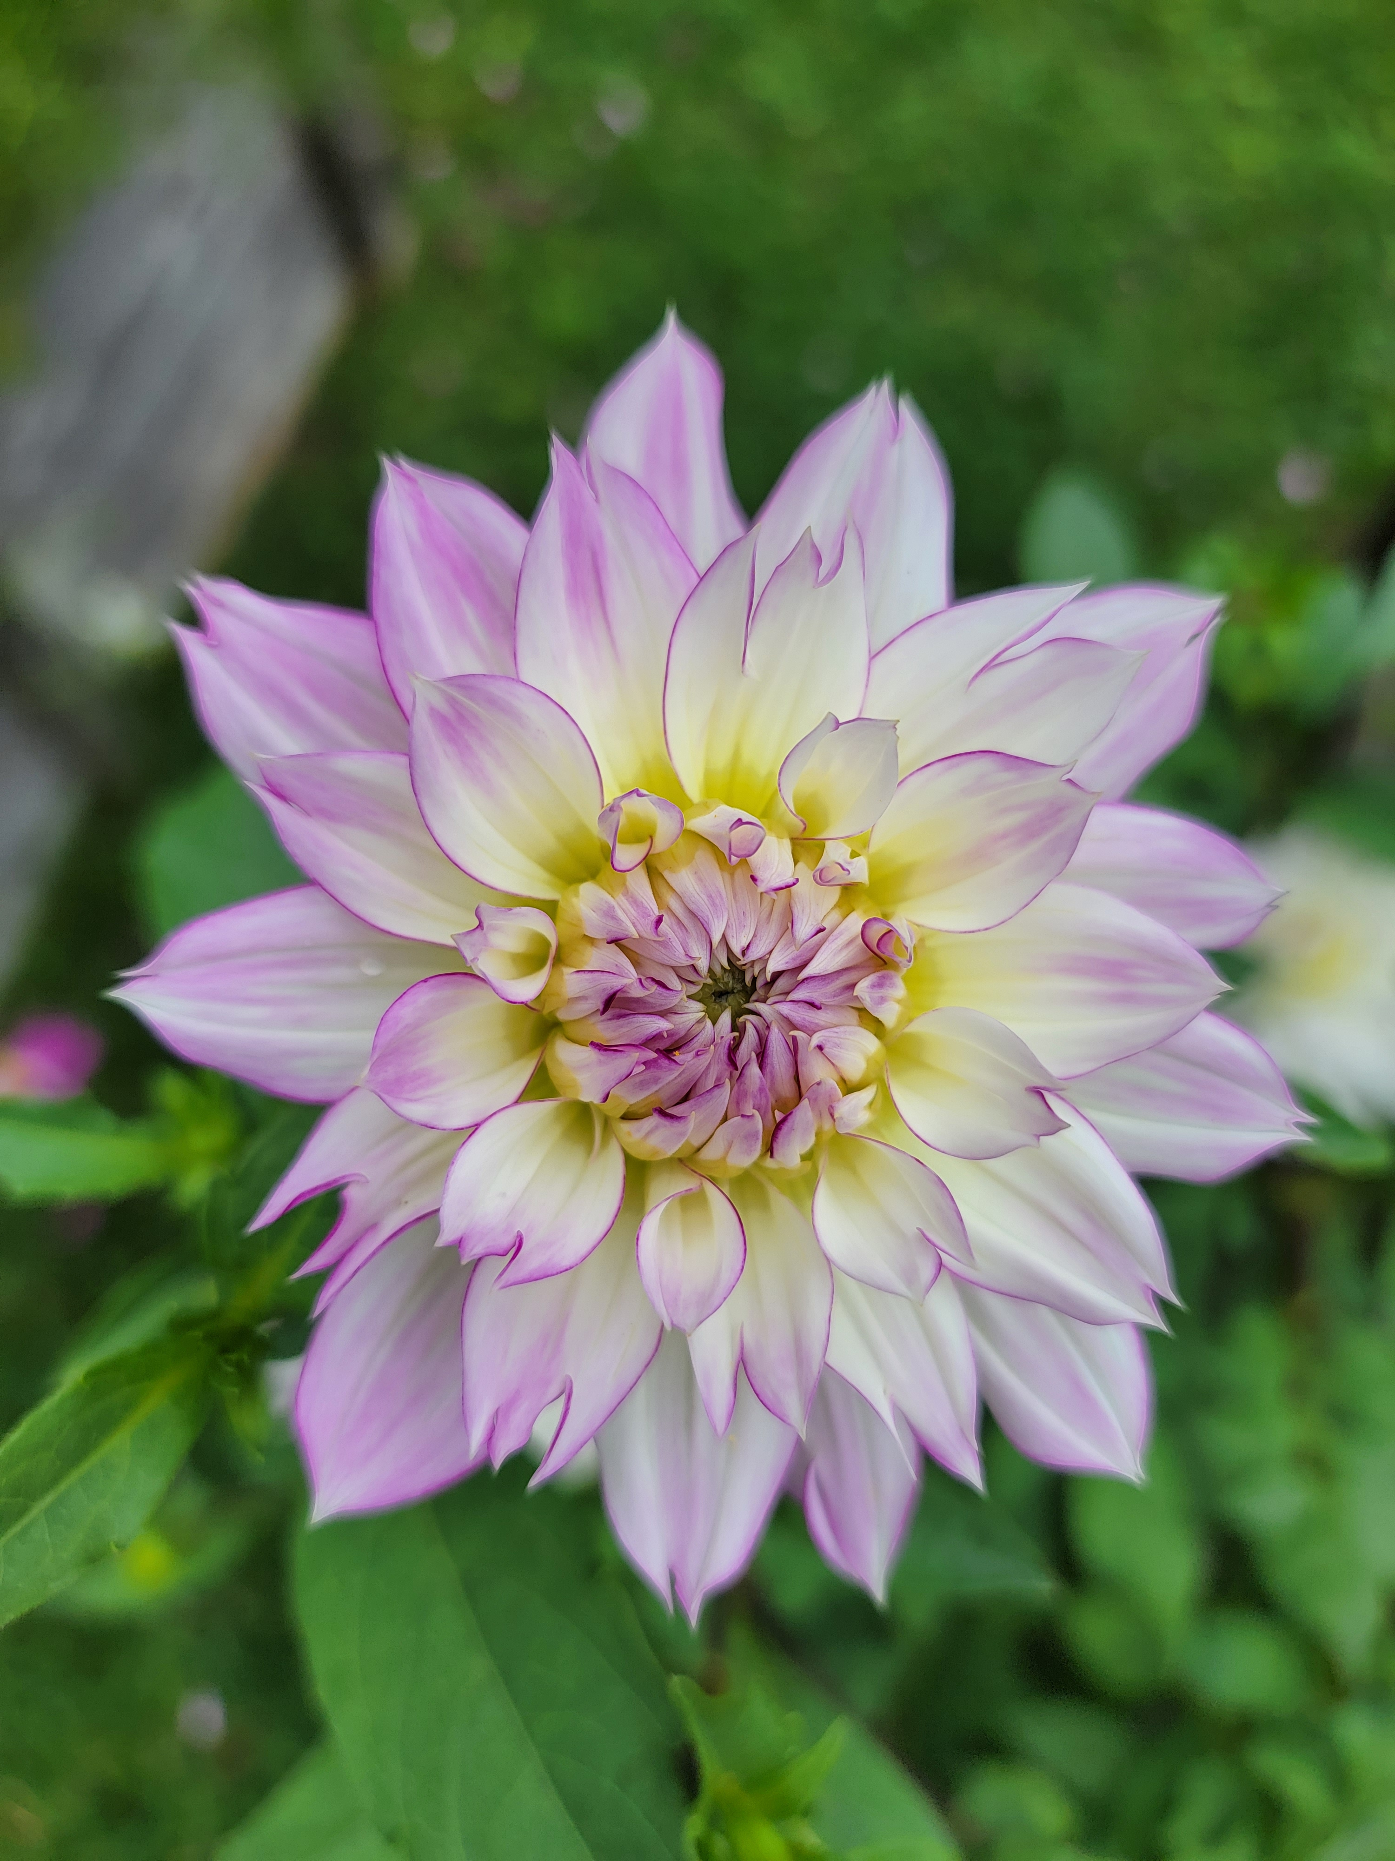

Slide 35
Resources
Wildflower Association of Michigan https://wildflowersmich.org/
MSU Extension Native Plants https://www.canr.msu.edu/nativeplants/
https://www.canr.msu.edu/nativeplants/plant_facts/local_info/upper_peninsula
Master Gardener https://www.michiganmastergardener.org/nurseries-featuring-native-plants
Tip of the Mitt Watershed Council https://www.watershedcouncil.org/native-plants.html
UP Native Plants https://www.upnativeplants.com/
Prairie Moon Nursery https://www.prairiemoon.com
Seed Savers Exchange https://www.seedsavers.org/

Slide 36
Thank you!
Questions? Advice?
Ashley Reitter
schoolcraftcd@macd.org

